Slide 1

Presenter Name
Presenter Organization
Notes:
Welcome to today’s program: “Rising Above the Opioid Epidemic”.
We have an opioid epidemic in America - the misuse of opioid pain medications (e.g., OxyContin®, Vicodin®, Percocet®) has skyrocketed, along with the use of illegal drugs like heroin and illicitly manufactured fentanyl. And drug overdose is now our leading cause of accidental death. This presentation will help us consider how we can rise above this serious public health problem.
This is a resource from “Generation Rx University”—an initiative which encourages college students and young adults to incorporate the Generation Rx key messages into their individual, everyday lives. These messages focus on how to safely use medications in an effort to prevent their misuse. This program will focus on prescription opioid pain relievers. We’ll discuss how misusing these medications can potentially lead to dependency and addiction and provide guidance on how to safely use them if prescribed by a healthcare provider. We will also discuss how to take action in a drug overdose situation.
Note for facilitator: we encourage you to access the video that accompanies this activity before you begin. This video is titled “The Impact of Misusing Prescription Opioids”, and it is posted with this activity on GenerationRx.org. Once you’ve accessed the video, minimize it on your computer until the slides prompt you to play it (slide 4).

Slide 2

Misusing medication is:
Taking more than prescribed
Taking medication for a reason different than prescribed
Sharing or taking someone else’s medication
Regardless of intentions…
^{©2020} ^{The Ohio State University}
Notes:
Transition: What is prescription drug misuse? We define prescription drug misuse as engaging in primarily three behaviors.
Taking more of a prescription medication than prescribed.
Taking a prescription medication for a reason different than that intended by the prescriber.
Sharing or taking someone else’s prescription medication.
And regardless of our intentions, engaging in any of these behaviors is misuse.
Note for facilitator: If asked, the National Institute of Health drafted and currently supports these definitions of prescription drug misuse.

Slide 3
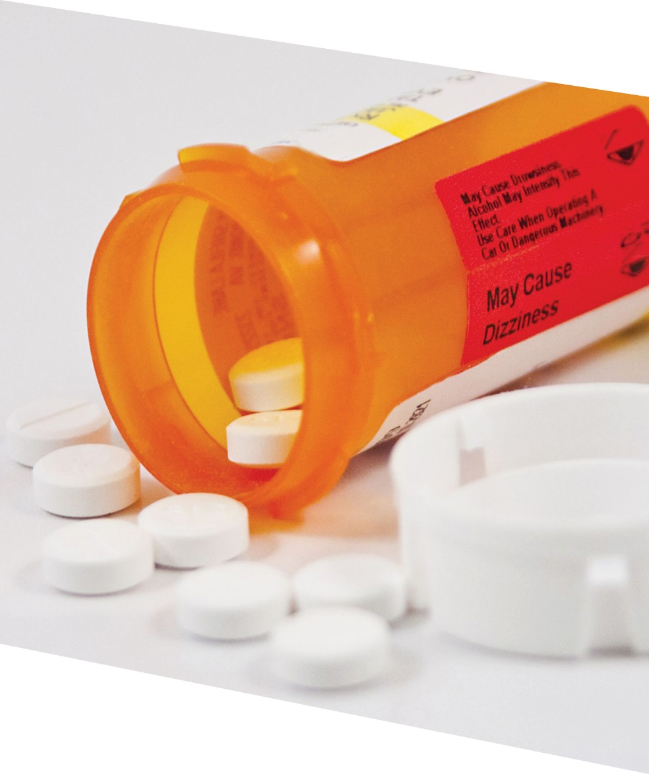

Think about it:
Some people misuse prescription opioid
pain relievers…
Do you think this
is a risky decision?
^{©2020} ^{The Ohio State University}
Notes:
Transition: Some people misuse prescription opioid pain relievers. Do you think this is a risky decision?
Let’s explore this question by first watching a video, and then we’ll engage in a series of discussions.

Slide 4

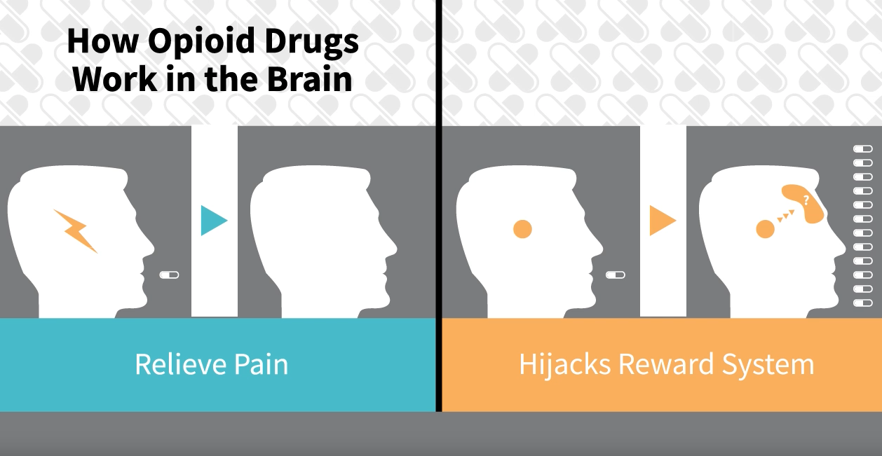
Video:
The Impact of Misusing Prescription Opioids
^{©2020} ^{The Ohio State University}
Notes:
Transition: Let’s watch a video that addresses risks inherent to the misuse of prescription opioids.
Note to facilitator: When you are ready to play the video, minimize this presentation. Once the video is complete, resume this presentation.

Slide 5
What do you think?
Is the misuse of prescription opioids a risky decision?
^{©2020} ^{The Ohio State University}
Notes:
Transition: Based on the video and your own understanding of this issue, is the misuse of prescription opioids a risky decision? What are potential problems or consequences resulting from misusing prescription opioids or heroin?
Note to facilitators: encourage participants to briefly share their thoughts aloud or through the chat thread – if you need help generating discussion, advance the slide and identify potential problems/consequences with additional talking points on the next slide.

Slide 6
drowsiness
expulsion from school
shallow breathing
drug overdose
addiction
legal fines
felony offense
nausea
decline in grades
confusion
jail
dependency
damaged relationships with family members or friends
loss of job
poor coordination
Notes:
Transition: After the discussion, you may consider simply summarizing the problems noted in the word cloud. Additional talking points associated with these problems are identified below:
Health-related consequences: as noted in the video, the most tragic consequence of prescription drug misuse affects our health -- including drug overdose, which is the leading cause of accidental death in the U.S. Emergency department visits and drug addiction treatment admissions relating to medication misuse have also escalated.
Legal consequences: we’ll discuss this in more detail later, but federal law prohibits the possession of controlled substances without a prescription (the types of prescription drugs which are most often misused without a prescription).
Social consequences: the misuse of medications can affect your family and friends, your job, your education, your finances, and much more.
Transition:
Before advancing the slide, pose this question: How do we avoid these problems?
Note to facilitators: encourage participants to share their thoughts aloud or within the chat thread. Ideas that will be discussed throughout the rest of the program are identified in the next slide.

Slide 7
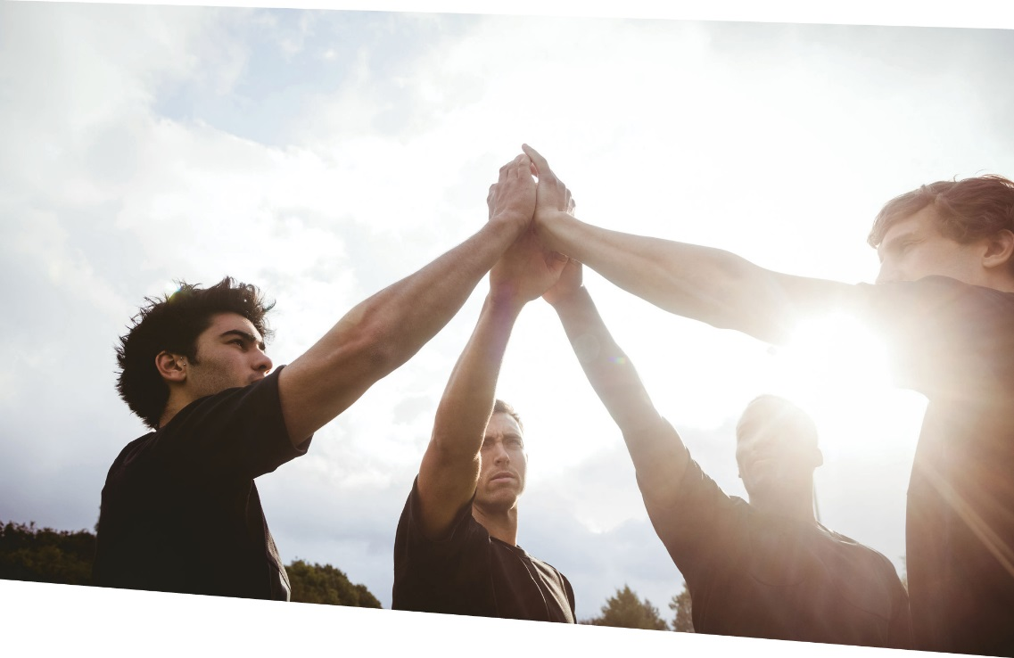


Rising above the opioid epidemic:
Only use prescribed
opioids as instructed by
a healthcare professional
Secure medications
Avoid mixing drugs
Seek positive alternatives
Ask for help
^{©2020} ^{The Ohio State University}
Notes:
Transition: We can rise above this epidemic by engaging in the following practices. How do we incorporate these practices into our everyday lives?
Let’s address this question by working through some scenarios. We’ll present three scenarios – for each scenario, I’ll pose several discussion questions. You’ll work in small groups to answer these questions.
Note to facilitator: to maximize interaction and engagement, we encourage you to utilize breakout rooms through your videoconferencing platform to facilitate discussion. For example, for each scenario, consider providing participants with the following instructions:
Divide participants into breakout rooms with 4-6 participants.
Once participants are in a small group or breakout room, ask them to appoint a group leader.
Encourage them to discuss the relevant discussion prompts for each scenario – the group leader can help navigate and summarize the conversation.
After a period of time, end the breakout rooms and resume the session with the larger group. Ask 1-2 group leaders to summarize their small group’s conversation – utilize the talking points and slides for each discussion module to reinforce or elaborate upon their ideas.

Slide 8
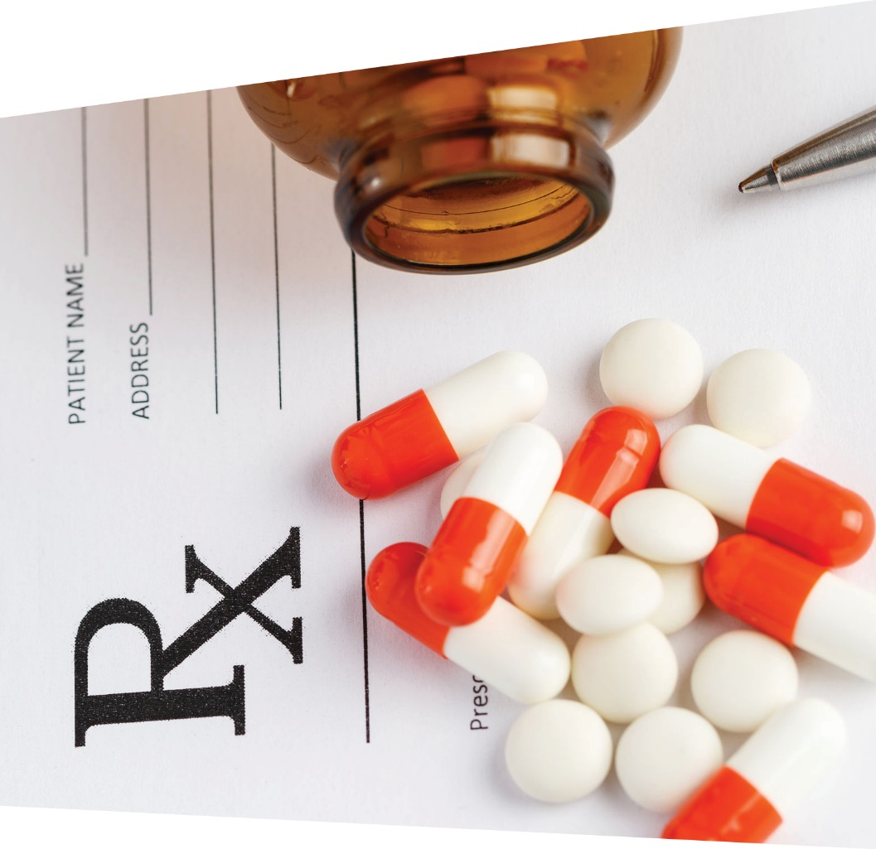
Scenario 1:
A healthcare provider prescribed you a prescription opioid pain reliever…
^{©2020} ^{The Ohio State University}
Notes:
Transition: Research indicates the #1 reason college students misuse prescription opioids is to relieve pain¹. In Scenario 1, let’s pretend that a healthcare provider prescribed you a prescription opioid pain reliever after experiencing a serious injury.
References:
¹Phillips & McDaniel (2018). College Prescription Drug Study Executive Summary. Center for the Study of Student Life, The Ohio State University.

Slide 9
Scenario 1: Legitimate Rx
How do you:
Store the medication?
Respond if your pain isn’t being relieved?
Dispose of the medication?
^{©2020} ^{The Ohio State University}
Notes:
Transition: If you receive a legitimate prescription for an opioid pain medication, how do you safely store or dispose of the medication, or respond if your pain isn’t being relieved?
Note to facilitator: to maximize interaction and engagement, we encourage you to utilize breakout rooms to facilitate discussion. For example, Scenario 1, consider providing participants with the following instructions:
Divide participants into breakout rooms with 4-6 participants.
Once participants are in a small group or breakout room, ask them to appoint a group leader.
Encourage them to discuss the relevant discussion prompts for each scenario – the group leader can help navigate and summarize the conversation.
After a period of time, end the breakout rooms and resume the session with the larger group. Ask 1-2 group leaders to summarize their small group’s conversation – utilize the talking points below and Slides 10-12 to reinforce or elaborate upon the ideas discussed.
Talking points for discussion questions:
How do you safely store the medication? Encourage participants to store medication in lockable spaces, such as lock-boxes, medication safes, or lockable medicine cabinets. Avoid storage places which children and others can easily access, such as unlocked drawers, nightstands, counters, or unlocked cabinets. We encourage these safe storage procedures, because most people who misuse prescription drugs get them from family members or friends.
How do you respond if your pain isn’t being relieved? This question is addressed in slide 10.
How do you safely dispose of medications? This question is addressed in slides 11-12.

Slide 10

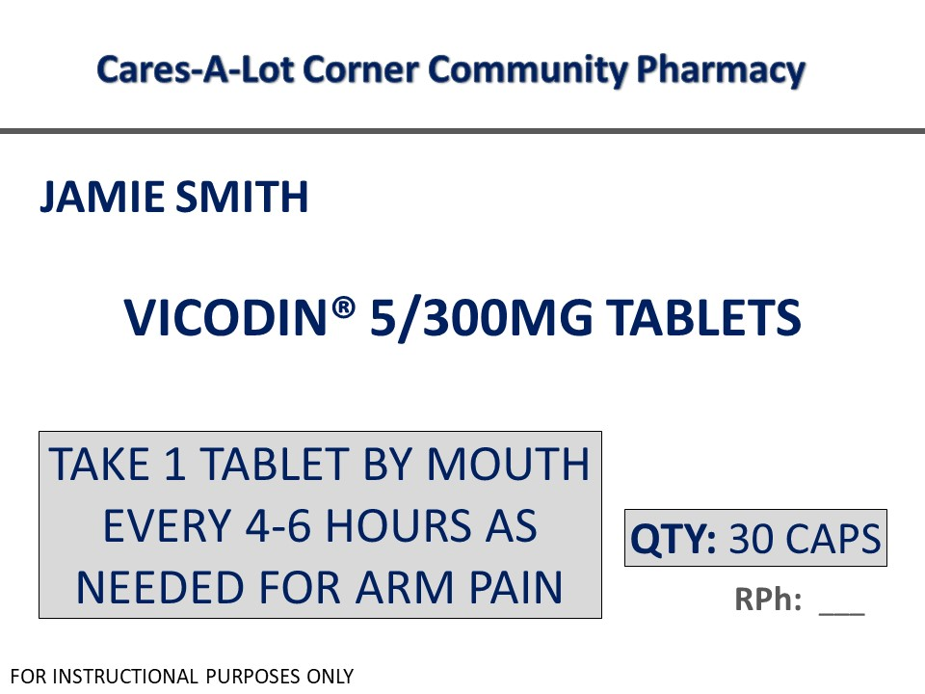
Avoid self-medicating—talk with your healthcare provider
1
How much and how often
2
Reason for medication
^{©2020} ^{The Ohio State University}
Notes:
Transition: If you are taking the prescription opioid as instructed and your pain isn’t being relieved—talk with your healthcare provider.
As demonstrated in the video, there is a risk for dependency and addiction with prescription opioids, even when taken as instructed. Therefore, avoid tendencies to self-diagnose and self-prescribe, which may increase your risk for experiencing these detrimental outcomes.
In addition, current medical guidelines indicate that prescription opioids should really only be used to manage acute pain (i.e., pain lasting for only a very short period of time). If you’re experiencing chronic pain (i.e., pain lasting more than three months), effective approaches that do not involve prescription opioids do exist. Again, talk with your healthcare provider to identify these options.
Lastly, when prescribed any medication—be your own advocate. Ensure you understand the reason for the medication and the dosing instructions. Don’t hesitate to ask questions when meeting with your healthcare providers.

Slide 11
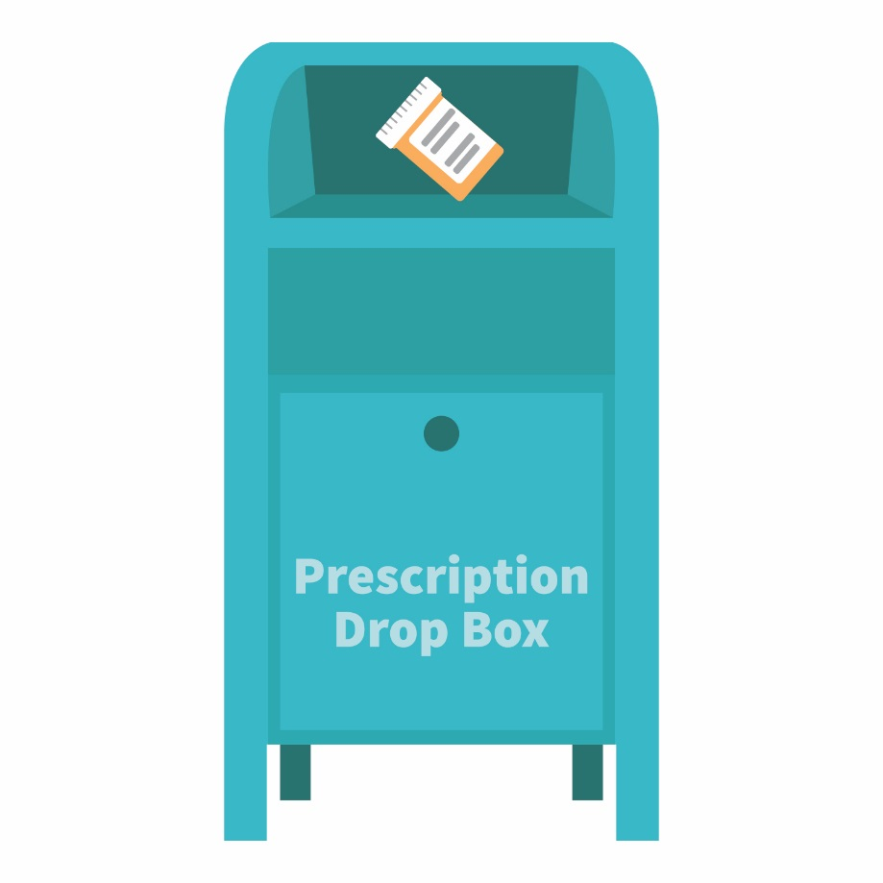
The best option for safe disposal?
Place the medication in a drug drop box or take advantage of a drug take-back event
Visit: safe.pharmacy/drug-disposal
^{©2020} ^{The Ohio State University}
Notes:
Transition: Once you are finished with the prescription, it is important to safely dispose of the medication. The majority of individuals that misuse prescription medications get them from their family members or friends.
Once finished with a prescription medication, the best options for safe disposal include:
Option #1: place the medication in a drug drop box. To find a drop box in your area, visit: rxdrugdropbox.org (or ask your campus pharmacy for campus-specific locations).
Option #2: take advantage of community drug take-back programs that allow the public to bring unused drugs to a central location for proper disposal. Call your local law enforcement agency or ask your pharmacist to see if a take-back program is available in your community.

Slide 12


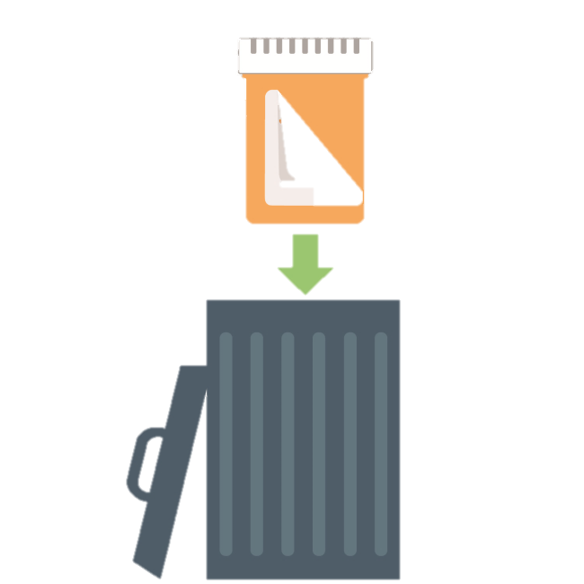

If needed, safely dispose of medications at home:
STEP
STEP
STEP
^{©2020} ^{The Ohio State University}
Notes:
Transition: If a drug drop box or a drug take-back event is not available, you can dispose of the medication at home.
Option #3: dispose of the medication at home (steps illustrated on this slide). Before completing these steps, we encourage you to follow any disposal instructions on the prescription label or patient information sheet.
If disposal instructions are not given, complete these three steps:
Step 1: Remove the pills from the original container and mix them with an undesirable substance such as used coffee grounds or kitty litter.
Step 2: Throw away the sealed mixture into the trash.
Step 3: Remove the prescription label and dispose of the empty bottle.
[Note: In general, you should not flush medications down a toilet or drain; however, the FDA still recommends that certain drugs should be disposed by flushing (for a list, visit: www.fda.gov).]

Slide 13

Scenario 2:
A friend invites you to misuse a prescription opioid…
^{©2020} ^{The Ohio State University}
Notes:
Transition: Let’s work through a second scenario—a friend invites you to misuse a prescription opioid pain reliever. Someone might offer you these types of drugs if you’re experiencing pain or because of the feelings of euphoria they cause. How do you handle this situation?

Slide 14
Scenario 2: Invitation to misuse
If invited to misuse:
Is it legal to possess or take medications
without a prescription?
Is mixing drugs a big deal?
How do you say “no”?
What are positive alternatives to misusing medication?
^{©2020} ^{The Ohio State University}
Notes:
Transition: Consider these questions: Is it legal to possess or take these products without a prescription? In general, is mixing drugs, especially prescription opioids with alcohol, a big deal? And how do you say “no”, as well as identify positive alternatives to misusing medications?
Note to facilitator: to maximize interaction and engagement, we encourage you to utilize breakout rooms to facilitate discussion. For example, Scenario 1, consider providing participants with the following instructions:
Divide participants into breakout rooms with 4-6 participants.
Once participants are in a small group or breakout room, ask them to appoint a group leader.
Encourage them to discuss the relevant discussion prompts for each scenario – the group leader can help navigate and summarize the conversation.
After a period of time, end the breakout rooms and resume the session with the larger group. Ask 1-2 group leaders to summarize their small group’s conversation – utilize the talking points below and Slides 15-17 to reinforce or elaborate upon the ideas discussed.
Talking points for discussion questions:
Is it legal to possess or take medications without a prescription? These medications are controlled by the U.S. Drug Enforcement Administration, and it is prohibited under federal law to manufacture, distribute, dispense, or possess them without a legitimate prescription.
Depending on individual state laws, possession of a controlled substance without a prescription may result in a felony charge, with penalties which could include fines and/or imprisonment.
If someone is hurt when you give them your prescription drugs, you could be liable for any harm experienced by the person to whom you provided the medication.
How would a drug-related offense impact your future? Note to facilitator: encourage participants to identify consequences. A felony offense appearing on your record can severely interfere with employment and education opportunities, such as graduate education, summer internships, or employment following graduation.
Is mixing drugs a big deal? This question is addressed on slide 15.
How do you say “no”? Ideas for saying “no” are identified on slide 16.
What are positive alternatives to misusing medication? Ideas for positive alternatives are identified on slide 17.

Slide 15
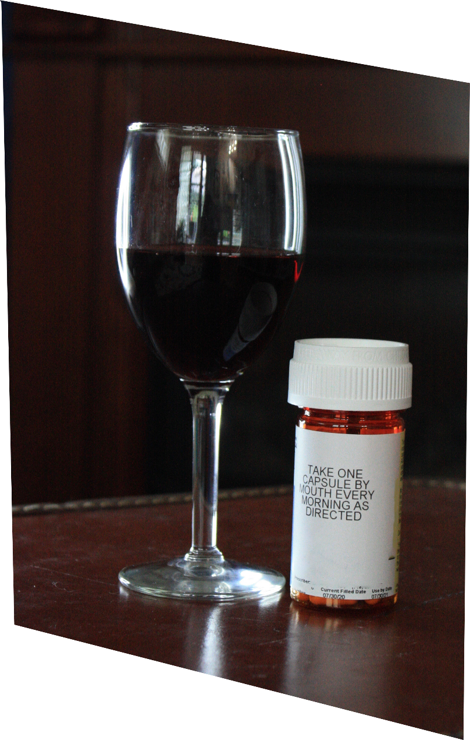
Mixing Rx opioids with alcohol or with Rx sedatives can cause dangerously slow breathing
^{©2020} ^{The Ohio State University}
Notes:
Transition: All prescription medications have side effects—and mixing alcohol with these products often enhances the negative side effects of the prescription medication.
For example, the adverse effects for prescription opioid pain medications include drowsiness, confusion, sedation, and slowed breathing. Mixing alcohol with prescription opioids can actually worsen these potentially harmful effects.
In fact, many drug overdoses result from mixing prescription opioids with alcohol or with prescription sedatives, which results in dangerously slow breathing that can cause death.

Slide 16

Need help saying “no”?
I’ve got some pain pills…want any?
Give a Reason:
No way…that’s illegal!
I don’t want a drug-related offense on
my record.
Suggest an alternative:
No…these pills can cause some serious side effects. Instead, how about we go to the football game?
Leave the situation:
If you feel uncomfortable, leave the situation and seek a safe way to have fun.
^{©2020} ^{The Ohio State University}
Notes:
Transition: If you’re invited to misuse any prescription medication, how do you turn down this invitation?
Note to facilitators: encourage participants to share their ideas. General approaches including giving a reason, leaving the situation, and suggesting an alternative. Examples are identified on this slide.

Slide 17

Try these positive alternatives…
travel
watch a movie
go to a concert
take a hike
attend a sporting event
host a game night
volunteer
enjoy your hobbies
^{©2020} ^{The Ohio State University}
Notes:
Transition: What are positive alternatives to misusing medication?
Note to facilitator: encourage participants to share their ideas. Examples of positive alternatives are identified on this slide.

Slide 18

Scenario 3:
You suspect someone has overdosed on an opioid drug…
How do you take action?
^{©2020} ^{The Ohio State University}
Notes:
Transition: Let’s discuss the final scenario—you suspect someone has overdosed on an opioid drug (e.g., heroin, a prescription opioid pain reliever, fentanyl). If you suspect someone has overdosed on any drug, how do you take action?
Note to facilitator: if time allows, consider utilizing a similar approach for discussion as with Scenarios 1-2. If you are running short on time, consider asking participants to utilize the chat thread to share their thoughts and ideas.

Slide 19
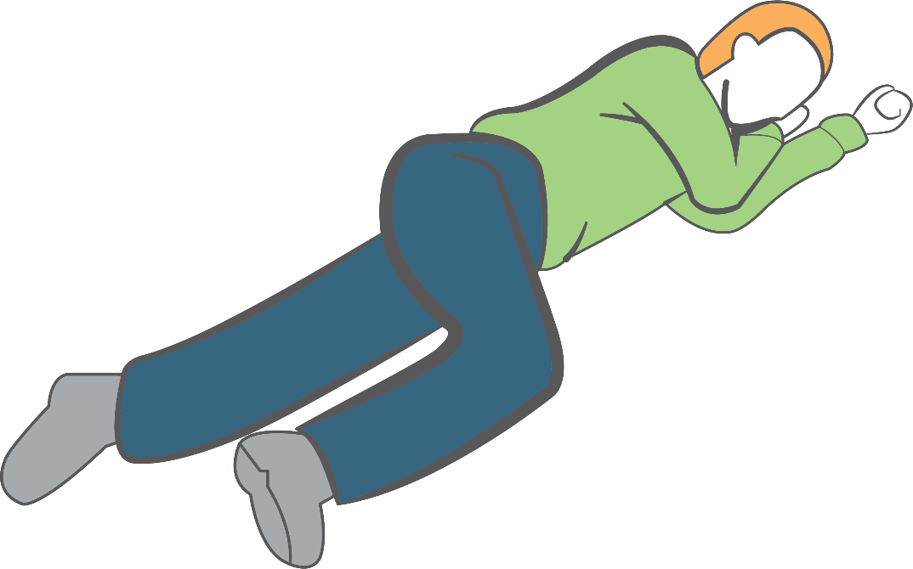
Take action in a drug overdose situation:
Call 9-1-1
If available, administer naloxone
Move individual to recovery position
Stay with the person until help arrives
Hand
supports
head
Knee stops
body from
rolling onto
stomach
^{©2020} ^{The Ohio State University}
Notes:
Transition: If you suspect someone has overdosed on any drug, how do you take action?
First, call 9-1-1.
Second, if available, administer naloxone. More information on naloxone is available on slide 20.
Third, move the individual to the recovery position (place the individual on their left side—place their arms under their head, and bend their right leg in order for their knee to stop their body from rolling onto their stomach). This position is designed to prevent suffocation.
Lastly, stay with the individual until help arrives.

Slide 20
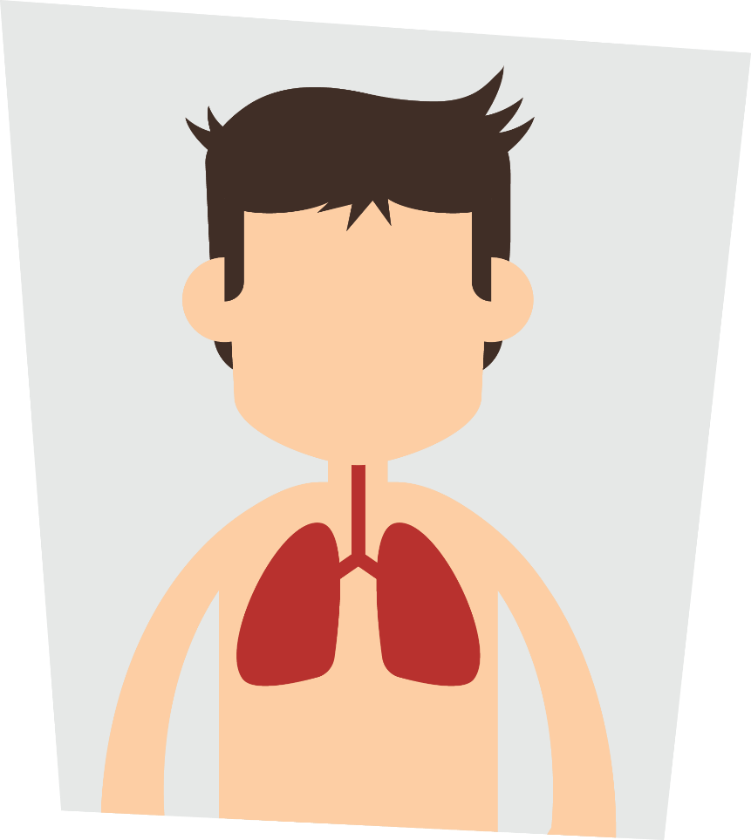
Naloxone reverses opioid drug overdoses
Delivery as an intranasal spray increasingly common
Naloxone access varies from state to state
Consider precautions with naloxone use
^{©2020} ^{The Ohio State University}
Notes:
Transition: an overdose occurs when too much of any opioid activates its target in the brainstem – this slows and then stops breathing. Naloxone knocks the opioid drug off this target – allowing breathing to resume. Naloxone wears off in 30-90 min; thus, calling 911 first ensures the person receives help before this happens.
Naloxone is available in various forms – the form packaged as a nasal spray (brand name Narcan®) is increasingly common.
You can get naloxone without a prescription, but accessing naloxone by the general public varies from state to state. Ask your local pharmacy or attend a community naloxone training session. The intranasal formulation (brand name Narcan®) is most widely used.For more information about naloxone access, visit:
https://www.networkforphl.org/_asset/qz5pvn/naloxone-_FINAL.pdf
http://pdaps.org/datasets/laws-regulating-administration-of-naloxone-1501695139
It is critical to remember two precautions regarding the use of naloxone (both reasons emphasize the importance of first calling 9-1-1):
Naloxone itself is safe and harmless. Because of naloxone’s actions in the body, it will precipitate withdrawal symptoms (e.g., vomiting, individual becomes combative or agitated) upon administration in an individual physically dependent on opioid drugs.
Naloxone only works in overdoses involving opioid drugs (e.g. OxyContin®, Vicodin®, heroin, fentanyl, etc.). If the patient actually overdosed on a non-opioid drug (prescription sedatives, alcohol, etc.), administering naloxone will have no effect and it will not rescue breathing. However, if you do not know what the person overdosed on, give naloxone anyways as it will not harm someone who has not taken opioids.
Note to facilitator: some students may ask about whether naloxone encourages future opioid use. Multiple scientific studies report that naloxone use does not increase future opioid use¹. Instead, studies report a high number of reversals with minimal adverse effects². Below is additional information on fentanyl, if interested:
Fentanyl is also a synthetic opioid pain reliever, typically prescribed for severe pain (like cancer-related pain) as a lozenge or transdermal patch. Fentanyl is a prescription opioid pain reliever that is now being illegally manufactured and used to contaminate the illicit drug supply. Because of its strong potency (50-100X more potent), only a small amount is needed to cause an overdose. Thus, now individuals that casually use opioid and non-opioid drugs (like cocaine, stimulants, or pressed pills) are exposed to fentanyl without their knowledge and thereby also at-risk for opioid-related overdoses. Collectively, these points emphasize the importance of calling 9-1-1 and administering naloxone (if available) during any drug overdose situation – naloxone is harmless, and can effectively reverse opioid-related drug overdoses caused by prescription opioids, heroin, and fentanyl.
Reference:
¹(Bazazi et.al., 2010; Doe-Simkins et.al., 2014; Lewis et.al., 2017)
²(Walley et.al., 2014; EMDDCA, 2015; McAuley, 2015; McDonald and Strang, 2016)

Slide 21

Need help? Use
Campus Resources:
Student health or
wellness center
Campus Recovery Programs
College or university counseling services
Academic advisors
^{©2020} ^{The Ohio State University}
Notes:
Transition: if you need help, we encourage you to use campus resources.
As with any disease, treatment options include both pharmacological (e.g., medication-assisted treatment using drugs like buprenorphine) and non-pharmacological (e.g., behavioral counseling) approaches. If you or someone you know needs help, campus resources such as the student health center, campus recovery programs, or campus counseling services can help identify appropriate treatment options.
Note to facilitator: prior to the presentation, we encourage you to customize this slide for your university. Discuss each resource with participants, and consider providing this information to participants through email or other digital platforms.

Slide 22

Share the information
Visit: GenerationRx.org
^{©2020} ^{The Ohio State University}
Notes:
Transition: In addition, we encourage you to share these messages with others.
This may consist of discussing Generation Rx messages with family and friends, or sharing them through peer-to-peer education. Visit our website, GenerationRx.org, to access free, ready-to-use resources designed to educate college students (or people of any age). You could present this program or a different activity. You could also present similar educational programs to other audiences, like teens, using our age-appropriate resources.

Slide 23
Rising above the opioid epidemic:
Only use prescribed
opioids as instructed by
a healthcare professional
Secure medications
Avoid mixing drugs
Seek positive alternatives
Ask for help
^{©2020} ^{The Ohio State University}
Notes:
Transition: In summary, we can each do our part to rise above the opioid epidemic by taking medication as instructed by a healthcare professional, securing medication through safe storage and disposal practices, not mixing drugs, seeking positive alternatives to better manage our lives, and if needed, asking for help.

Slide 24




GenerationRx.org
Follow us
@TheGenRx
^{©2020} ^{The Ohio State University}
Notes:
Transition: Does anyone have any questions or comments?
Before we end, we encourage you to stay connected by following us @TheGenRx on Twitter and Facebook. We also encourage you to share your experience with us. Consider submitting your tips and personal experiences about how you advocate safe medication practices at home or in your community. To do this, visit the ‘Contact’ section of GenerationRx.org. In this same section, you can also submit any questions you may have regarding how to use these educational resources.

