Slide 1
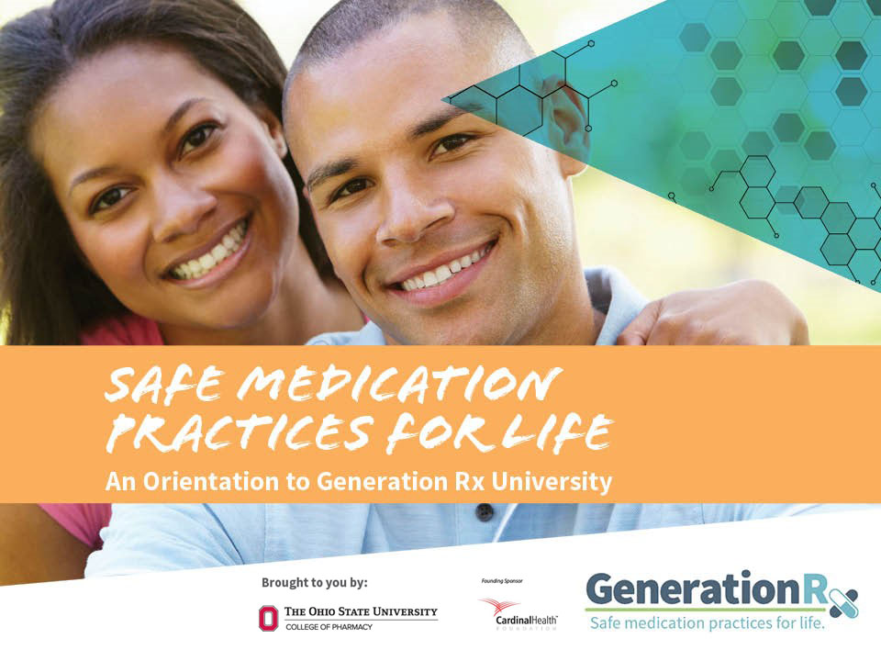

Presenter Name
Presenter Organization
Notes:
Presentation Talking Points
Welcome to today’s program: “Safe Medication Practices for Life: An Orientation to Generation Rx University”.
This is a resource from “Generation Rx University”—an initiative which encourages college students and young adults to incorporate the Generation Rx key messages into their individual, everyday lives. This presentation provides an overview of Generation Rx University messages designed to educate college students toward “safe medication practices for life.” We will focus on specific issues relating to opioid and stimulant medications, as well as some key general guidelines for safe medication-taking practices.
Note to Presenters
We encourage you to access the videos that accompany this activity before you begin. These videos include: “The Impact of Misusing Prescription Opioids”, “The Impact of Misusing Prescription Stimulants”, and “Safe Medication Practices for Life” - all are posted with this activity on GenerationRx.org. Once you’ve accessed the videos, minimize them on your computer until the slides prompt you to play each video.

Slide 2
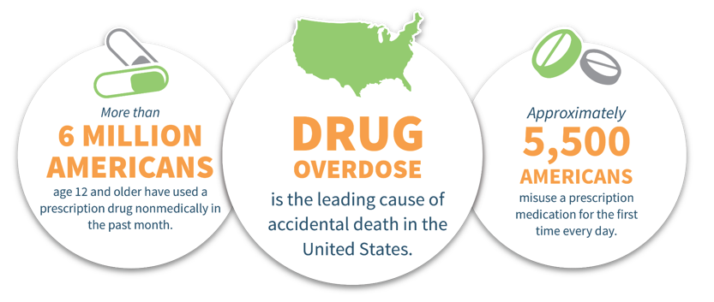

Prescription drug misuse is a national epidemic
^{©2020} ^{The Ohio State University}
Notes:
Presentation Talking Points
Prescription drug misuse is a national epidemic. Prescriptions medications can help us live longer and healthier lives when used as directed by a health professional, but the dangers of misusing prescription drugs are real.
More than 6 million Americans age 12 and older have used a prescription drug nonmedically (i.e., they’ve misused this product) in the past month¹.
More than 5,500 Americans misuse a prescription medication for the first time every day¹
Note: this number is derived from averaging past year initiates – in 2018, the number of Americans aged 12 or older who initiated misuse of a prescription medication for the first time averages to about 8,590 individuals per day (initiation of prescription pain reliever misuse comprises 5,200 individuals)¹. The statistic of 5,500 Americans was the average calculated from the NSDUH 2015 survey.
Any medication can produce adverse health effects, and drug overdose is now our leading cause of accidental death.
Among all age groups, the most commonly misused prescription drugs are opioid pain medications (e.g., Vicodin®, OxyContin®), prescription stimulants (e.g., Adderall®, Ritalin®), and prescription sedatives (e.g., Xanax®, Valium®).

Slide 3
Misusing medication is:
Taking more than prescribed
Taking medication for a reason different than prescribed
Sharing or taking someone else’s medication
Regardless of intentions…
^{©2020} ^{The Ohio State University}
Notes:
Presentation Talking Points
What is meant by “prescription drug misuse”? We define misuse as engaging in primarily three behaviors.
Taking more of a prescription medication than prescribed.
Taking a prescription medication for a reason (or in a way) different than that intended by the prescriber.
Sharing or taking someone else’s prescription medication.
And regardless of our intentions, engaging in any of these behaviors is misuse.

Slide 4
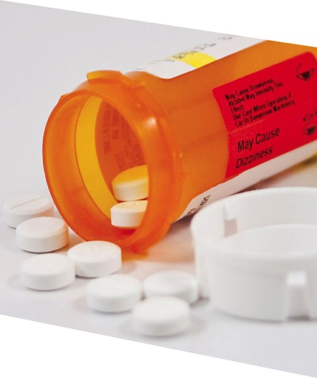

Think about it:
Some people misuse prescription drugs…
Do you think this
is a risky decision?
^{©2020} ^{The Ohio State University}
Notes:
Presentation Talking Points
Some people misuse prescription drugs like opioid pain relievers , sedatives or stimulants. And we are here to consider important reasons why doing so can be harmful. But before we get started, what do you think? Is using a prescription medication that is not prescribed for you or in a different way than your health professional intended a risky decision?
Note to Presenters
Encourage participants to engage in self-reflection regarding this question - inform them that you’ll discuss different aspects of this question throughout the program.

Slide 5

Today, we’ll consider important issues relating to…
Module 1: Prescription Opioids
Module 2: Prescription Stimulants
Module 3: Safe Medication Practices
Each module consists of watching a short video and engaging in a brief discussion
^{©2020} ^{The Ohio State University}
Notes:
Presentation Talking Points
Today’s program will include three modules. Each module consists of watching a short video, reviewing a few additional slides relating to the topic, and engaging in a brief discussion around some thought-provoking questions. Module topics include the misuse of prescription opioid pain relievers and prescription stimulants, as well as consideration of a few general safe medication practices.
Note to Presenters:
To maximize interaction and engagement, we encourage you to utilize breakout rooms to facilitate discussion. For example, for each module, consider providing participants with the following instructions:
Divide participants into breakout rooms with 4-6 participants.
Once participants are in a small group or breakout room, ask them to appoint a group leader.
Encourage them to discuss the relevant discussion prompts for each module – the group leader can help navigate and summarize the conversation.
After a period of time, end the breakout rooms and resume the session with the larger group. Ask 1-2 group leaders to summarize their small group’s conversation – utilize the talking points and slides for each discussion module to reinforce or elaborate upon their ideas.

Slide 6

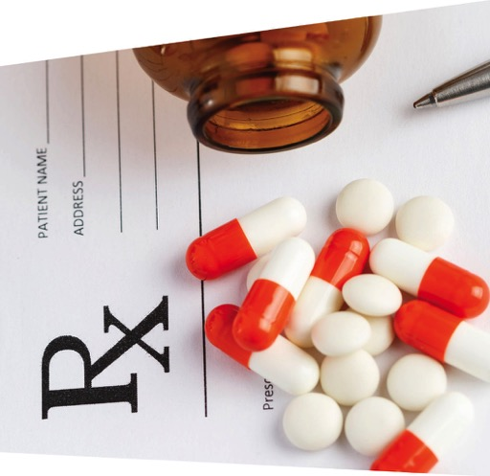
Module 1:
Prescription
Opioids
^{©2020} ^{The Ohio State University}
Notes:
Presentation Talking Points
We have an opioid epidemic in America - the misuse of opioid pain medications (e.g., OxyContin®, Vicodin®, Percocet®) has increased, along with the use of illegal drugs like heroin and illicitly manufactured fentanyl. Let’s discuss these topics further in Module 1.

Slide 7

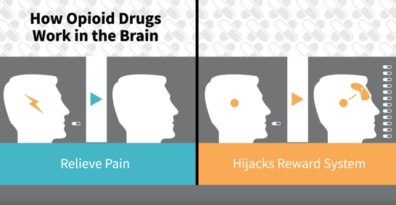
Video:
The Impact of Misusing Prescription Opioids
^{©2020} ^{The Ohio State University}
Notes:
Presentation Talking Points
Let’s begin by watching a short video that addresses risks inherent to the misuse of prescription opioids.
Note to Presenters
The video is posted online at: http://www.generationrx.org/take-action/college/. When you are ready to play the video, minimize this presentation. Once the video is complete, resume the presentation.

Slide 8

Module 1:
Discuss in small groups:
Am I putting myself at risk if I take prescription opioids and drink alcohol at the same time?
Is a transition to using heroin common for those who misuse prescription opioids?
What other problems may arise from misusing prescription opioids?
^{©2020} ^{The Ohio State University}
Notes:
Presentation Talking Points
Let’s engage in a brief discussion about some of the points addressed in this video. Here are three discussion questions – based on the video and your own understanding of this issue, try developing a response to these questions.
Note to Presenters
To maximize interaction and engagement, we encourage you to utilize breakout rooms to facilitate discussion. For example, consider providing participants with the following instructions in order to discuss the prompts on this slide:
Divide participants into breakout rooms with 4-6 participants.
Once participants are in a small group or breakout room, ask them to appoint a group leader.
Encourage them to discuss the three prompts on this slide – the group leader can help navigate and summarize the conversation.
After a period of time, end the breakout rooms and resume the session with the larger group. For each discussion question, ask 1-2 group leaders to summarize their small group’s conversation – slides 9 – 16 feature each discussion question along with accompanying supportive slides and talking points. Utilize these slides as needed to help reinforce or elaborate upon the ideas shared.

Slide 9
Module 1:
Discuss in small groups:
Am I putting myself at risk if I take prescription opioids and drink alcohol at the same time?
^{©2020} ^{The Ohio State University}
Notes:
Note to Presenters
You can utilize this slide as a placeholder for 1-2 group leaders to share a summary of their small group conversation – Slide 10 contains content and talking points that can help reinforce or elaborate upon the ideas shared.

Slide 10
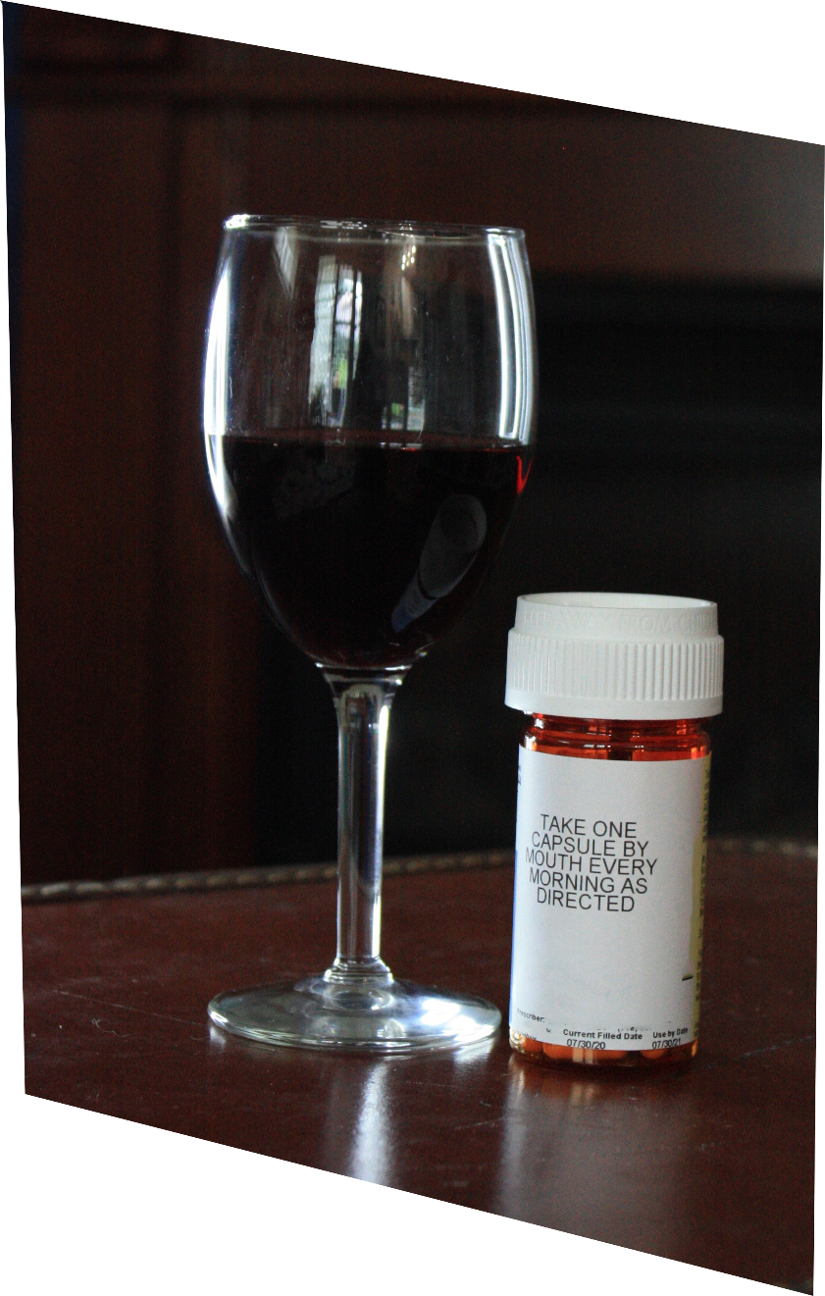
Mixing Rx opioids with alcohol or with Rx sedatives can cause dangerously slow breathing
^{©2020} ^{The Ohio State University}
Notes:
Presentation Talking Points
All medications have side effects—and mixing alcohol with prescription drugs can sometimes enhance these negative effects.
For example, adverse side effects for prescription opioid pain medications include drowsiness, confusion, sedation, and slowed breathing. Drinking alcohol at the same time can actually worsen these potentially harmful effects.
In fact, many drug overdoses result from mixing prescription opioids with alcohol, prescription sedatives, or other drugs – which results in dangerously slow breathing and can cause death.

Slide 11
Module 1:
Discuss in small groups:
Am I putting myself at risk if I take prescription opioids and drink alcohol at the same time?
Is a transition to using heroin common for those who misuse prescription opioids?
^{©2020} ^{The Ohio State University}
Notes:
Note to Presenters
You can utilize this slide as a placeholder for 1-2 group leaders to share a summary of their small group conversation – Slide 12 contains content and talking points that can help reinforce or elaborate upon the ideas shared.

Slide 12
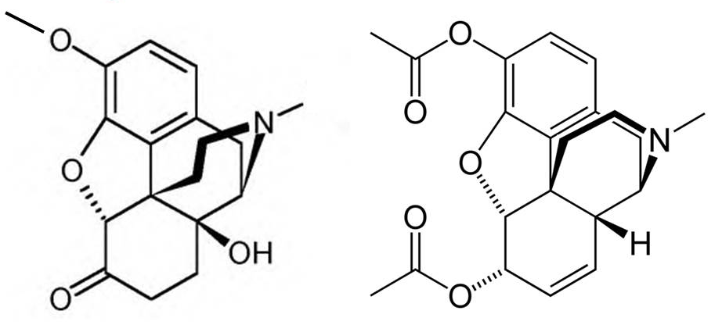
Some individuals who misuse prescription opioids transition to using heroin…
Drugs with similar chemistry produce similar effects in the body…
Oxycodone
Heroin
^{©2020} ^{The Ohio State University}
Notes:
Presentation Talking Points
Some individuals who misuse prescription opioids can transition to using heroin.
Recall from the video that because prescription opioids and heroin share similar chemistry, they also produce similar effects in the body. Because these effects are nearly identical, individuals who misuse and become dependent upon prescription opioids sometimes transition to using heroin in order to experience the same (or stronger) effect. In many cases, heroin may also be easier (and cheaper) to obtain. In fact, there has been a substantial increase in the use of heroin, with approximately 75% of users reporting misusing prescription opioids first².
Your brain doesn’t care if society labels a drug as an illicit street drug or a prescription drug. If the two drugs share similar chemistry, they’ll produce similar effects in the body, including increased risk for drug dependence and addiction. This relationship between prescription opioids and heroin is certainly troubling and serves as another reason to avoid misusing prescription opioids.

Slide 13
Module 1:
Discuss in small groups:
Am I putting myself at risk if I take prescription opioids and drink alcohol at the same time?
Is a transition to using heroin common for those who misuse prescription opioids?
What other problems may arise from misusing prescription opioids?
^{©2020} ^{The Ohio State University}
Notes:
Note to Presenters
You can utilize this slide as a placeholder for 1-2 group leaders to share a summary of their small group conversation – Slides 14-16 contain content and talking points that can help reinforce or elaborate upon the ideas shared.

Slide 14
drug rehab
expulsion from school
drug overdose
legal fines
drowsiness
addiction
shallow breathing
felony offense
nausea
decline in grades
confusion
jail
dependency
damaged relationships with family members or friends
loss of job
Emergency department visits
^{©2020} ^{The Ohio State University}
Notes:
Presentation Talking Points
Those who misuse prescription opioids sometimes spiral into drug dependency or addiction and experience the harmful health, legal and social consequences that can follow.
Health-related consequences: as noted in the video, the most tragic consequences of prescription drug misuse affect our health -- including drug overdose, which is the leading cause of accidental death in the U.S. Emergency department visits and drug addiction treatment admissions relating to medication misuse have also escalated.
Legal consequences: federal law prohibits the possession of the types of medications which are most often misused without a prescription.
Social consequences: the misuse of medications can affect your family and friends, your job, your education, your finances, and much more.
Note to Presenters
If participants have already identified these problems, consider simply summarizing the problems noted in the word cloud.

Slide 15
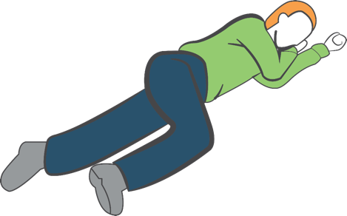
Take action in a drug overdose situation:
Hand
supports
head
Call 9-1-1
Move individual to recovery position
If available, administer naloxone
Stay with the person until help arrives
Knee stops
body from
rolling onto
stomach
^{©2020} ^{The Ohio State University}
Notes:
Presentation Talking Points
If you suspect someone has overdosed on any drug or alcohol, how can you take action?
First, call 9-1-1.
Second, move the individual to the recovery position (place the individual on their left side—with their arms under their head, bending their right leg to prevent them from rolling onto their stomach). This position is designed to prevent suffocation if the individual vomits.
Third, if available, administer naloxone. More information on naloxone will be provided in the next slide.
Lastly, stay with the individual until help arrives.

Slide 16
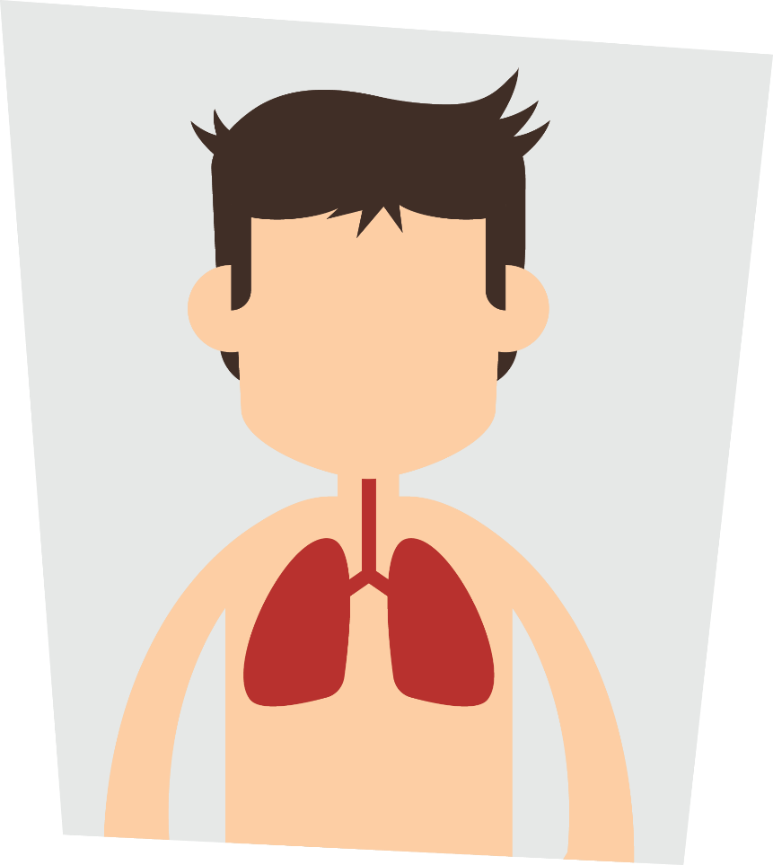
Naloxone reverses opioid drug overdoses
Delivery as an intranasal spray increasingly common
Naloxone access varies from state to state
Consider precautions with naloxone use
^{©2020} ^{The Ohio State University}
Notes:
Presentation Talking Points
An overdose occurs when too much of any opioid activates its target in the brainstem – this slows and then stops breathing. Naloxone knocks the opioid drug off this target – allowing breathing to resume. Naloxone wears off in 30-90 min; thus, calling 911 first ensures the person receives help before this happens.
Naloxone is available in various forms – the form packaged as a nasal spray (brand name Narcan®) is increasingly common.
You can get naloxone without a prescription, but accessing naloxone by the general public varies from state to state. Ask your local pharmacy or attend a community naloxone training session. The intranasal formulation (brand name Narcan®) is most widely used.For more information about naloxone access, visit:
https://www.networkforphl.org/_asset/qz5pvn/naloxone-_FINAL.pdf
http://pdaps.org/datasets/laws-regulating-administration-of-naloxone-1501695139
It is critical to remember two precautions regarding the use of naloxone (both reasons emphasize the importance of first calling 9-1-1):
Naloxone itself is safe and harmless. Because of naloxone’s actions in the body, it will precipitate withdrawal symptoms (e.g., vomiting, individual becomes combative or agitated) upon administration in an individual physically dependent on opioid drugs.
Naloxone only works in overdoses involving opioid drugs (e.g. OxyContin®, Vicodin®, heroin, fentanyl, etc.). If the patient actually overdosed on a non-opioid drug (prescription sedatives, alcohol, etc.), administering naloxone will have no effect and it will not rescue breathing. However, if you do not know what the person overdosed on, give naloxone anyways as it will not harm someone who has not taken opioids.
Note to Presenters
Some students may ask about whether naloxone encourages future opioid use. Multiple scientific studies report that naloxone use does not increase future opioid use¹. Instead, studies report a high number of reversals with minimal adverse effects². Below is additional information on fentanyl, if interested:
Fentanyl is also a synthetic opioid pain reliever, typically prescribed for severe pain (like cancer-related pain) as a lozenge or transdermal patch. Fentanyl is a prescription opioid pain reliever that is now being illegally manufactured and used to contaminate the illicit drug supply. Because of its strong potency (50-100X more potent), only a small amount is needed to cause an overdose. Thus, now individuals that casually use opioid and non-opioid drugs (like cocaine, stimulants, or pressed pills) are exposed to fentanyl without their knowledge and thereby also at-risk for opioid-related overdoses. Collectively, these points emphasize the importance of calling 9-1-1 and administering naloxone (if available) during any drug overdose situation – naloxone is harmless, and can effectively reverse opioid-related drug overdoses caused by prescription opioids, heroin, and fentanyl.
Reference:
¹(Bazazi et.al., 2010; Doe-Simkins et.al., 2014; Lewis et.al., 2017)
²(Walley et.al., 2014; EMDDCA, 2015; McAuley, 2015; McDonald and Strang, 2016)

Slide 17


Module 2:
Prescription
Stimulants
^{©2020} ^{The Ohio State University}
Notes:
Presentation Talking Points
We’ve discussed the impact of misusing prescription opioids. Now, let’s switch our attention to prescription stimulant misuse.

Slide 18
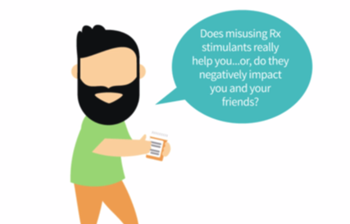
Video:
The Impact of Misusing Prescription Stimulants
^{©2020} ^{The Ohio State University}
Notes:
Presentation Talking Points
Let’s watch a video that addresses risks inherent to the misuse of prescription stimulants. Then, we’ll engage in a brief discussion.
Note to Presenters
The video is posted online at: http://www.generationrx.org/take-action/college/. When you are ready to play the video, minimize this presentation. Once the video is complete, resume this presentation.

Slide 19

Module 2:
Discuss in small groups:
Can the misuse of prescription stimulants improve your grades?
When you ask someone for their medication,
how do you think this request makes them feel?
Is mixing alcohol with prescription stimulants a big deal?
^{©2020} ^{The Ohio State University}
Notes:
Presentation Talking Points
Let’s engage in a brief discussion about some of the points addressed in this video. Here are three discussion questions – based on the video and your own understanding of this issue, try developing a response to these questions.
Note to Presenters
To maximize interaction and engagement, we encourage you to utilize breakout rooms to facilitate discussion. For example, consider providing participants with the following instructions in order to discuss the prompts on this slide:
Divide participants into breakout rooms with 4-6 participants.
Once participants are in a small group or breakout room, ask them to appoint a group leader.
Encourage them to discuss the three prompts on this slide – the group leader can help navigate and summarize the conversation.
After a period of time, end the breakout rooms and resume the session with the larger group. For each discussion question, ask 1-2 group leaders to summarize their small group’s conversation – slides 20 – 26 feature each discussion question along with accompanying supportive slides and talking points. Utilize these slides as needed to help reinforce or elaborate upon the ideas shared.

Slide 20
Module 2:
Discuss in small groups:
Can the misuse of prescription stimulants improve your grades?
^{©2020} ^{The Ohio State University}
Notes:
Note to Presenters
You can utilize this slide as a placeholder for 1-2 group leaders to share a summary of their small group conversation – Slide 21 contains content and talking points that can help reinforce or elaborate upon the ideas shared.

Slide 21
Students who misuse prescription stimulants typically have lower grade-point averages, and they…
Have fewer academic achievements
Commit an illegal act that places several people at risk
Violate codes of student conduct
Risk losing scholarships and internships
^{©2020} ^{The Ohio State University}
Notes:
Presentation Talking Points
Research shows that students who misuse prescription stimulants typically have lower grade-point averages⁴.
Health professionals, administrators, friends, and parents should view this behavior as concerning, as it may indicate that the student is struggling academically, experiencing a mental health condition, or using other legal or illegal drugs⁴.
As the video identified, when we ask another individual for their stimulant medication, we are asking them to commit an illegal act that also places them at risk. This risk includes legal concerns and personal liability for any harm that might come from medications that they provide to others.
Depending on individual state laws, possession of a controlled substance (e.g., Adderall®, Ritalin®) without a prescription may result in a felony charge, with penalties which could include fines and/or imprisonment. How would a drug-related offense impact your future?
By definition, if we break a law, we also violate most codes of student conduct.
In addition to violating codes of student conduct, a felony offense appearing on your record could interfere with employment and educational opportunities, such as scholarships, graduate education, summer internships, or employment following graduation.
Lastly, it’s important to remember that misusing prescription stimulants is not the norm on college campuses. In fact, the vast majority of college students (84%) do not misuse prescription stimulants⁵.

Slide 22
Module 2:
Discuss in small groups:
Can the misuse of prescription stimulants improve your grades?
When you ask someone for their medication, how do you think this request makes them feel?
^{©2020} ^{The Ohio State University}
Notes:
Note to Presenters
You can utilize this slide as a placeholder for 1-2 group leaders to share a summary of their small group conversation – Slide 23 contains content and talking points that can help reinforce or elaborate upon the ideas shared.

Slide 23

When we ask someone to share their medication, they may perceive it as you…
Putting me at risk for getting in trouble…
Using our friendship to obtain drugs…
Disrespecting my health needs…
^{©2020} ^{The Ohio State University}
Notes:
Presentation Talking Points
If you ask someone to sell or share their medication, have you ever considered how that friend may perceive your request?
By asking a friend (or even a stranger) for some of their medication, we put them in an incredibly vulnerable and uncomfortable position. For example, they often perceive that request as you:
Using your friendship to obtain drugs. Your friend may begin questioning whether your friendship is solely based on you gaining access to their medication.
Disrespecting their health needs. Your friend has a legitimate need for their medication. If they give it to others, they may not be able to take their medication as instructed, and their health could jeopardized.
Putting them at risk for getting in trouble. Even if your friend simply gives (versus sells) you the medication, sharing medication is always illegal. Think about it—would a real friend ask someone to risk their future so that they could misuse a medication?
Be a good friend—if you feel that you need medication for a legitimate reason, talk with your healthcare provider.

Slide 24
Module 2:
Discuss in small groups:
Can the misuse of prescription stimulants improve your grades?
When you ask someone for their medication,
how do you think this request makes them feel?
Is mixing alcohol with prescription stimulants a big deal?
^{©2020} ^{The Ohio State University}
Notes:
Note to Presenters
You can utilize this slide as a placeholder for 1-2 group leaders to share a summary of their small group conversation – Slides 25-26 contains content and talking points that can help reinforce or elaborate upon the ideas shared.

Slide 25
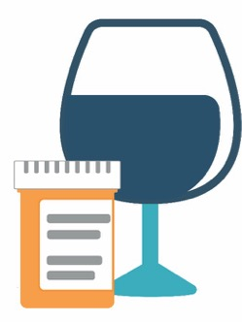
Mixing alcohol and prescription stimulants sends the body mixed messages…
Decreases heart rate
Increases heart rate
Slows messages between body and brain…
Triggers “fight or flight” response…
…and increases your risk for dangerous levels of intoxication
^{©2020} ^{The Ohio State University}
Notes:
Presentation Talking Points
Mixing alcohol with prescription stimulants is a big deal, because it sends the body mixed messages and increases your risk for dangerous levels of intoxication.
The orange text bubbles highlight effects produced by prescription stimulants; the blue text bubbles highlight effects produced by alcohol. Some individuals incorrectly perceive that these mixed messages cancel each other out. However, because alcohol and stimulants produce these effects through different mechanisms, these mixed messages don’t cancel each other out. Rather, the body is receiving all of these messages simultaneously. Thus, these mixed messages simply confuse the body and place it at risk for dangerous consequences.
Note that alcohol reduces heart rate, whereas stimulants increase heart rate. These mixed messages may cause an irregular heart beat.
In addition, alcohol slows messages between the body and brain, yet prescription stimulants activate part of the nervous system to trigger the fight or flight response. These mixed messages confuse the body and increase the risk for dangerous levels of alcohol intoxication, as well as other potential harms resulting from risky drinking.

Slide 26
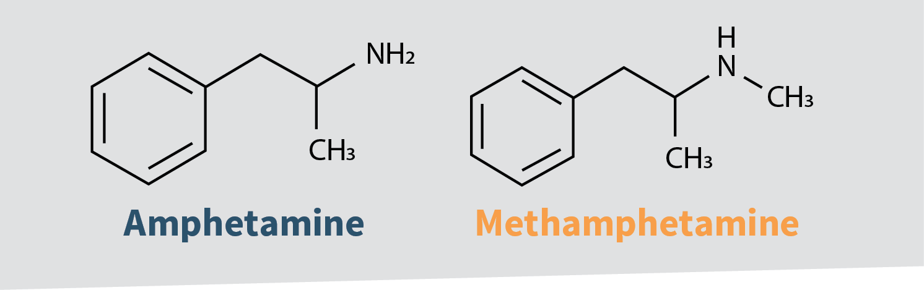
Some prescription drugs aren’t as safe as you think…
Remember: Drugs with similar chemistry produce similar effects in the body…
^{©2020} ^{The Ohio State University}
Notes:
Presentation Talking Points
Recall from the video that the legal drug amphetamine (a prescription stimulant), and the illegal drug, methamphetamine, share similar chemical structures. As we discussed earlier, drugs with similar chemistry produce similar effects in the body. So misusing these substances may not be as safe as you think.
Adverse effects associated with prescription stimulant misuse include headaches, insomnia, increased heart rate, agitation, nausea, and anxiety.
In addition, because methamphetamine and amphetamine both activate the brain’s reward pathway (think back to the “Prescription Opioid” video), misuse of either drug increases the risk of drug dependency and addiction.

Slide 27


Module 3:
Safe Medication Practices
^{©2020} ^{The Ohio State University}
Notes:
Presentation Talking Points
We’ve discussed the impact of misusing prescription opioids and stimulants. Now, let’s discuss how we can avoid the potential consequences of prescription drug misuse by using medications safely.

Slide 28
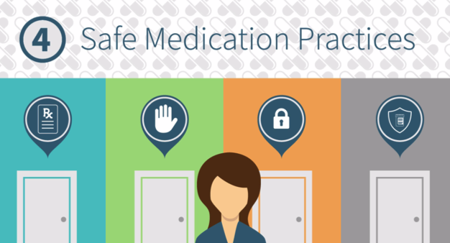
Video:
Safe Medication Practices
^{©2020} ^{The Ohio State University}
Notes:
Presentation Talking Points
Let’s watch a video that outlines safe medication practices. Then, we’ll engage in a brief discussion.
Note to Presenters
The video is posted online at: http://www.generationrx.org/take-action/college/. When you are ready to play the video, minimize this presentation. Once the video is complete, resume this presentation.

Slide 29

Module 3:
Discuss in small groups:
If you have a legitimate prescription, how should you respond if your condition isn’t improving?
How do you say “no”…
What are positive alternatives to misusing medications?
What are some safe medication practices for life?
^{©2020} ^{The Ohio State University}
Notes:
Presentation Talking Points
Let’s engage in a brief discussion about some of the points addressed in this video. Here are four discussion questions – based on the video and your own understanding of this issue, try developing a response to these questions.
Note to Presenters
To maximize interaction and engagement, we encourage you to utilize breakout rooms to facilitate discussion. For example, consider providing participants with the following instructions in order to discuss the prompts on this slide:
Divide participants into breakout rooms with 4-6 participants.
Once participants are in a small group or breakout room, ask them to appoint a group leader.
Encourage them to discuss the three prompts on this slide – the group leader can help navigate and summarize the conversation.
After a period of time, end the breakout rooms and resume the session with the larger group. For each discussion question, ask 1-2 group leaders to summarize their small group’s conversation – slides 30 – 40 feature each discussion question along with accompanying supportive slides and talking points. Utilize these slides as needed to help reinforce or elaborate upon the ideas shared.

Slide 30
Module 3:
Module 3:
Discuss in small groups:
If you have a legitimate prescription, how should you respond if your condition isn’t improving? How should you store or dispose of the medication?
^{©2020} ^{The Ohio State University}
Notes:
Note to Presenters
You can utilize this slide as a placeholder for 1-2 group leaders to share a summary of their small group conversation – Slides 31-34 contains content and talking points that can help reinforce or elaborate upon the ideas shared.

Slide 31

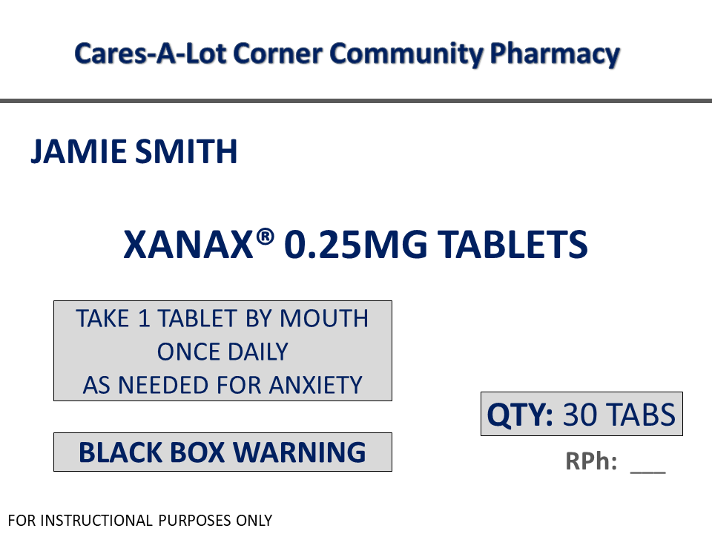
Avoid self-medicating—talk with your healthcare provider
1
How much and how often
2
Warnings
^{©2020} ^{The Ohio State University}
Notes:
Presentation Talking Points
If you are taking a medication as instructed and your condition isn’t improving—talk with your healthcare provider.
When prescribed any medication—be your own advocate. Ensure you understand the reason for the medication and the dosing instructions. Don’t hesitate to ask questions when meeting with your healthcare providers.
Some medications, like prescription sedatives (e.g., Xanax® and Valium®) even contain special “black box” warnings in the package insert materials required by the Food and Drug Administration. For prescription sedatives, this warning informs patients that breathing may be slowed or it may stop altogether if they take prescription sedatives with prescription opioids, or with other drugs that depress the nervous system (like alcohol). As we discussed earlier, many drug overdoses result from mixing prescription opioids, alcohol, prescription sedatives, or other drugs.
As highlighted in our videos, there is a risk for dependency and addiction with some prescription drugs, even when taken as instructed. Therefore, avoid tendencies to self-diagnose and self-prescribe, which may increase your risk for experiencing these detrimental outcomes.
In addition, if a friend or family members asks for some of your sedative medication, encourage them to seek professional help from a healthcare provider. There is a prescription for a reason – these medications are only deemed safe and effective when taken under the supervision of a healthcare provider.
Note to Presenters
If needed, below is additional information on prescription sedatives:
Prescription drugs like Xanax® and Valium® are members of the “Benzodiazepine” drug class. In the body, these drugs function as CNS depressants. That is, they act to inhibit nervous system function and slow messages between the brain and body. Thus, physicians may prescribe prescription sedatives to treat anxiety or panic disorder. However, it’s critical to take these medications as instructed and only by the individual for whom the medication was prescribed. Adverse effects for prescription sedatives include decreased heart rate and blood pressure, impaired coordination and judgement, confusion, sedation, and slowed breathing. In fact, the FDA requires a “black box” warning for all benzodiazepine drugs related to these adverse effects. A “black box” warning constitutes FDA’s strongest cautionary information for patients.

Slide 32

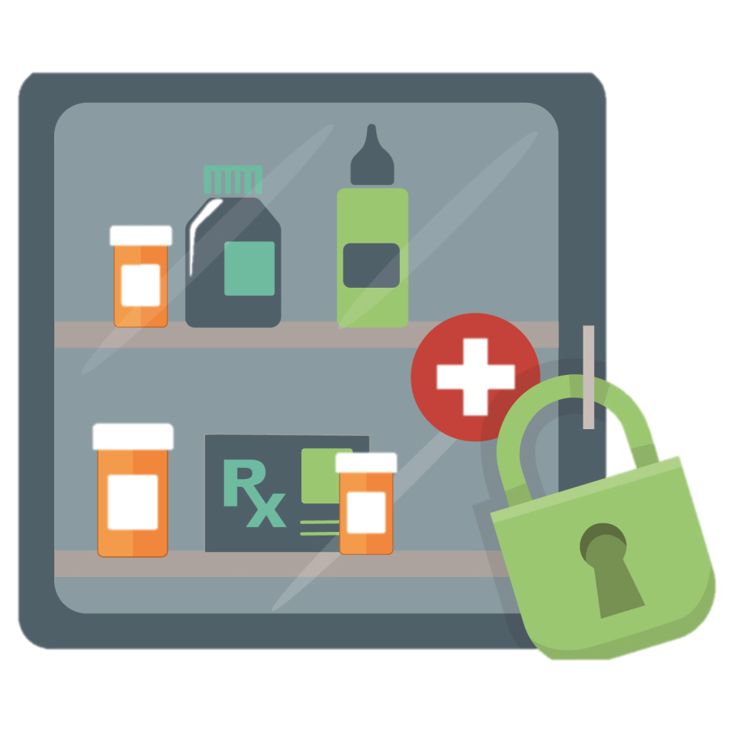
Store
medication in lockable spaces
^{©2020} ^{The Ohio State University}
Notes:
Presentation Talking Points
Remember that most people who misuse prescription drugs get them from family members or friends. Help keep those around you safe by storing your medications in lockable spaces.
Store prescription drugs in secure locations such as lock-boxes, medication safes, or other lockable spaces.
Avoid storage places which children and others can easily access, such as purses, backpacks, un-locked drawers, nightstands, or counters.

Slide 33
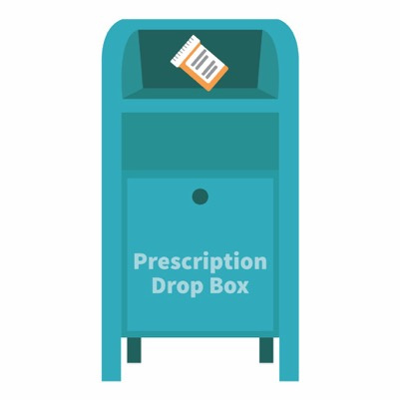
The best option for safe disposal?
Place the medication in a drug drop box or take advantage of a drug take-back event
Visit: safe.pharmacy/drug-disposal
^{©2020} ^{The Ohio State University}
Notes:
Presentation Talking Points
Similarly, it is important to safely dispose of your medications when they are no longer needed. The best options for safe disposal include:
Option #1: place the medication in a drug drop box. To find a drop box in your area, visit: rxdrugdropbox.org
Option #2: take advantage of community drug take-back programs that allow the public to bring unused drugs to a central location for proper disposal. Call your local law enforcement agency or ask your pharmacist to see if a take-back program is available in your community.

Slide 34


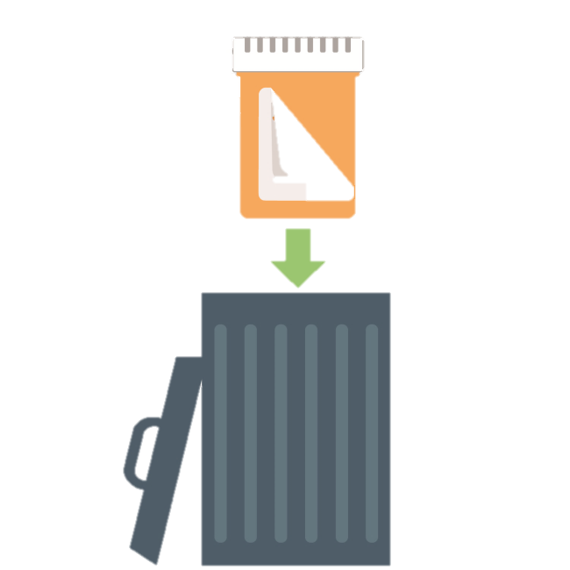

If needed, safely dispose of medications at home:
STEP
STEP
STEP
^{©2020} ^{The Ohio State University}
Notes:
Presentation Talking Points
If a drug drop box or a drug take-back event is not available, you can dispose of the medication at home. In general, you should not flush medications down a toilet or drain; however, the FDA still recommends that certain drugs should be disposed by flushing (for a list, visit: www.fda.gov).
Option #3: dispose of the medication at home (steps illustrated on this slide). Before completing these steps, we encourage you to follow any disposal instructions on the prescription label or provided patient information sheets.
If disposal instructions are not given, complete these three steps:
Step 1: Remove the pills from the original container and mix them with an undesirable substance such as used coffee grounds or kitty litter.
Step 2: Throw away the sealed mixture into the trash.
Step 3: Remove the prescription label and dispose of the empty bottle.

Slide 35
Module 3:
Discuss in small groups:
If you have a legitimate prescription, how should you respond if your condition isn’t improving? How should you store or dispose of the medication?
How do you say “no” if invited to misuse someone else’s medication; or, if someone asks for your medication?
^{©2020} ^{The Ohio State University}
Notes:
Presentation Note to Presenters
You can utilize this slide as a placeholder for 1-2 group leaders to share a summary of their small group conversation – Slide 36 contains content and talking points that can help reinforce or elaborate upon the ideas shared.

Slide 36

Need help saying “no”?
I’ve got some pain pills…want one?
I’m so stressed – can I have some of your Xanax®?
Give a Reason:
No way…that’s illegal!
I don’t want a drug-related offense on my record.
Leave the situation:
If you feel uncomfortable, leave the situation and seek a safe way to have fun, study, etc.
Suggest an alternative:
No…these pills can cause some serious side effects. Instead, how about we…
^{©2020} ^{The Ohio State University}
Notes:
Presentation Talking Points
If you’re invited to misuse any prescription medication, how do you turn down this invitation? Alternatively, if someone requests that you share or sell your prescription medication, how can you say no? Three examples are listed on this slide. General approaches including giving a reason, leaving the situation, and suggesting an alternative. In addition, you can simply say “no” – by doing so, you become one of the majority of college students who use medications safely.
Note to Presenters
Some strategies are provided on this slide – encourage participants to share other ideas.

Slide 37
Module 3:
Discuss in small groups:
If you have a legitimate prescription, how should you respond if your condition isn’t improving?
How do you say “no”…
What are positive alternatives to misusing medications?
^{©2020} ^{The Ohio State University}
Notes:
Note to Presenters
You can utilize this slide as a placeholder for 1-2 group leaders to share a summary of their small group conversation – Slide 38 contains content and talking points that can help reinforce or elaborate upon the ideas shared.

Slide 38
Try these positive alternatives to misusing medications…
travel
watch a movie
go to a concert
start a study group
attend a sporting event
talk with your professor
don’t skip class
enjoy your hobbies
^{©2020} ^{The Ohio State University}
Notes:
Presentation Talking Points
Some people misuse prescription medications as a “quick fix” to deal with the pressures and demands of their lives. However, they are only a “quick fix” – life will continually present demands, stresses, and pressures. Learning healthy, positive ways to deal with stress, achieve academic success, or have fun safely is essential. Isn’t college a time when you should cultivate sustainable habits for future professional success? Consider the examples in this slide. What are other positive alternatives to misusing medications?
Note to Presenters
Encourage participants to share their ideas. Alternatives in green provide sustainable approaches to studying.

Slide 39
Module 3:
Discuss in small groups:
If you have a legitimate prescription, how should you respond if your condition isn’t improving?
How do you say “no”…
What are positive alternatives to misusing medications?
What are some safe medication practices for life?
^{©2020} ^{The Ohio State University}
Notes:
Note to Presenters
You can utilize this slide as a placeholder for 1-2 group leaders to share a summary of their small group conversation – Slide 40 contains content and talking points that can help reinforce or elaborate upon the ideas shared.

Slide 40
Safe Medication Practices for Life
1
Only use prescription medications
as directed by a health professional
Do not share or take someone else’s medication
Keep your medications safe
Model safe medication practices
2
3
4
^{©2020} ^{The Ohio State University}
Notes:
Presentation Talking Points
Prescription medications can help us live longer and healthier lives, but any medication has the potential to do harm – especially when misused. The misuse of prescription medications is one of our country’s most pressing public health problems, with drug overdose being our leading cause of accidental death. We can prevent prescription drug misuse by engaging in safe medication practices for life. This includes only using medications as directed by a health professional, not sharing or taking someone else’s medication, securing and safely disposing of medications, and lastly, by being a good role model. This includes modeling these practices at home, and encouraging your family and friends to do the same.

Slide 41

Need help?
Use Campus Resources:
Student health or
wellness center
Campus Recovery
Programs
College or university counseling services
Academic advisors
^{©2020} ^{The Ohio State University}
Notes:
Presentation Talking Points
That concludes our program. Let’s wrap-up by discussing where you can find help and learn more about these issues.
If you need help with regard to your misuse of medications, we encourage you to use the campus resources identified on this slide. Visit your student health or wellness center, contact the campus recovery program (if available), utilize campus counseling services, or talk with your advisor. The first step to solving any problem like alcohol or drug misuse may be reaching out for help.
Note to Presenters
Prior to the presentation, we encourage you to customize this slide to show the resources available at your university. Discuss each resource with participants, and consider providing this information to participants through email or other digital platforms.

Slide 42

Share the information
Visit: GenerationRx.org
^{©2020} ^{The Ohio State University}
Notes:
Presentation Talking Points
In addition, we encourage you to share these messages with others.
This may consist of discussing Generation Rx messages with family and friends, or sharing them through peer-to-peer education. Visit our website, GenerationRx.org, to access free, ready-to-use resources designed to educate college students (or people of any age). You could present this program or a different activity. You could also present similar educational programs to other audiences, like teens, using our age-appropriate resources.

Slide 43




GenerationRx.org
Follow us
@TheGenRx
^{©2020} ^{The Ohio State University}
Notes:
Presentation Talking Points
Does anyone have any questions or comments? Before we end, we encourage you to stay connected by following us @TheGenRx on Twitter and Facebook.
Note to Presenters
We also encourage you to share your experience with us. Consider submitting your tips and personal experiences about how you advocate safe medication practices at home or in your community. To do this, visit the ‘Contact’ section of GenerationRx.org. In this same section, you can also submit any questions you may have regarding how to use these educational resources.
References
Substance Abuse and Mental Health Services Administration. (2019). Key substance use and mental health indicators in the United States: Results from the 2018 National Survey on Drug Use and Health, (HHS Publication No. PEP19-5068, NSDUH Series H-54). Rockville, MD: Center for Behavioral Health Statistics and Quality, Substance Abuse and Mental Health Services Administration, Retrieved from http://www.samhsa.gov/data/
Compton WM, Jones CM, and Baldwin GT (2016) Relationship between Nonmedical Prescription-Opioid Use and Heroin Use. N Engl J Med, 374:154-63, DOI:10.1056/NEJMra1508490.
Center for Disease Control and Prevention, National Center for Injury Prevention and Control (2019, May 31). Fentanyl. Centers for Disease Control and Prevention. Retrieved September 23, 2019, from https://www.cdc.gov/drugoverdose/opioids/fentanyl.html
Amelia M. Arria PhD & Robert L. DuPont MD (2010) Nonmedical Prescription Stimulant Use Among College Students: Why We Need to Do Something and What We Need to Do, Journal of Addictive Diseases, 29:4, 417-426, DOI:10.1080/10550887.2010.509273
Phillips and McDaniel (2018). College Prescription Drug Study Executive Summary. Center for the Study of Student Life, The Ohio State University.

