Slide 1

Presenter Name
Presenter Organization
Notes:
Welcome to today’s program: “Rising Above the Opioid Epidemic”.
We have an opioid epidemic in America, because the misuse of opioid pain medications (e.g., OxyContin, Vicodin, Percocet, Fentanyl) has skyrocketed, often leading to the use of illegal drugs like heroin. And drug overdose is now our leading cause of accidental death. This presentation will help us consider how we can rise above this serious public health problem.
This is a resource from “Generation Rx University”—an initiative which encourages college students and young adults to incorporate the Generation Rx key messages into their individual, everyday lives. These messages focus on how to safely use medications in an effort to prevent their misuse. This program will focus on prescription opioid pain relievers. We’ll discuss how misusing these medications can potentially lead to dependency and addiction and provide guidance on how to safely use them. We will also discuss how to take action in a drug overdose situation.
Note for facilitator: we encourage you to access the video that accompanies this activity before you begin. This video is titled “The Impact of Misusing Prescription Opioids”, and it is posted with this activity on GenerationRx.org. Once you’ve accessed the video, minimize it on your computer until the slides prompt you to play it (slide 4).

Slide 2
Misusing medication is:
Taking more than prescribed
Taking medication for a reason different than prescribed
Sharing or taking someone else’s medication
Regardless of intentions…
Notes:
Transition: What is prescription drug misuse? We define prescription drug misuse as engaging in primarily three behaviors.
Taking more of a prescription medication than prescribed.
Taking a prescription medication for a reason different than that intended by the prescriber.
Sharing or taking someone else’s prescription medication.
And regardless of our intentions, engaging in any of these behaviors is misuse.
Note for facilitator: If asked, the National Institute of Health drafted and currently supports these definitions of prescription drug misuse.

Slide 3
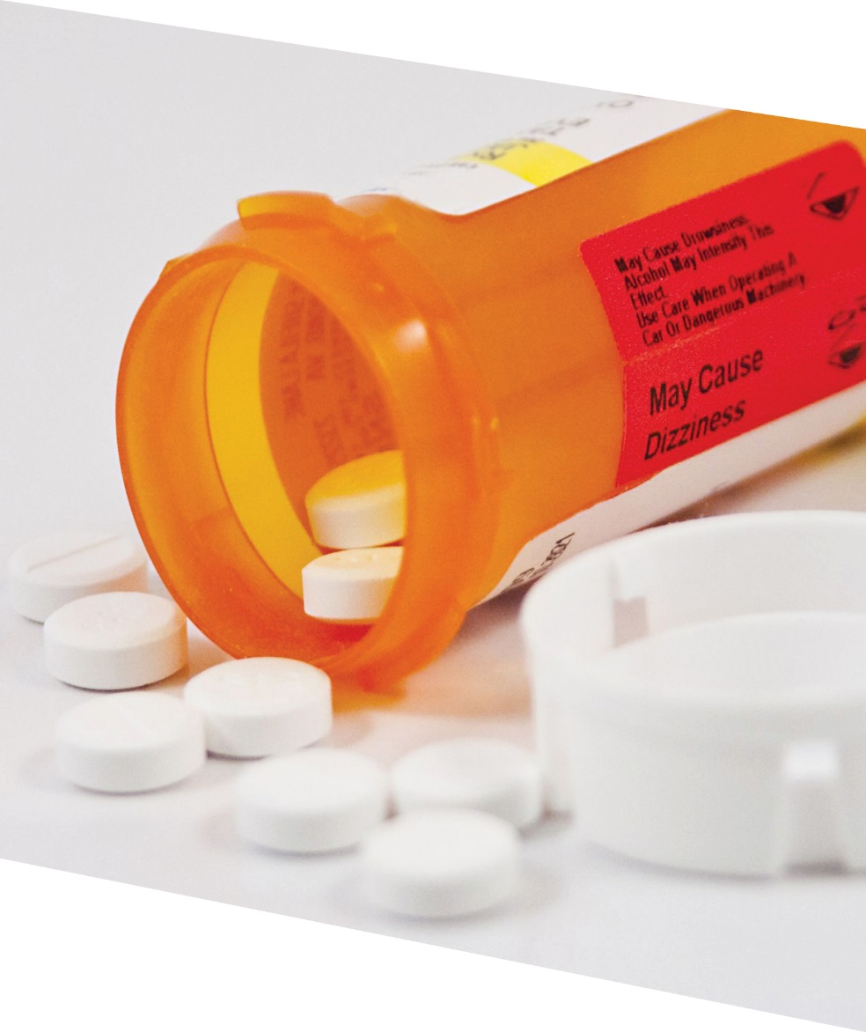

Think about it:
Some people misuse prescription opioid
pain relievers…
Do you think this
is a risky decision?
Notes:
Transition: Some people misuse prescription opioid pain relievers. Do you think this is a risky decision?
Note to facilitators: encourage participants to discuss this question with their nearby peers, or utilize the “notecard swapping” technique identified in the facilitator guide. After the discussion, inform participants that you’ll show a video that addresses this question.

Slide 4

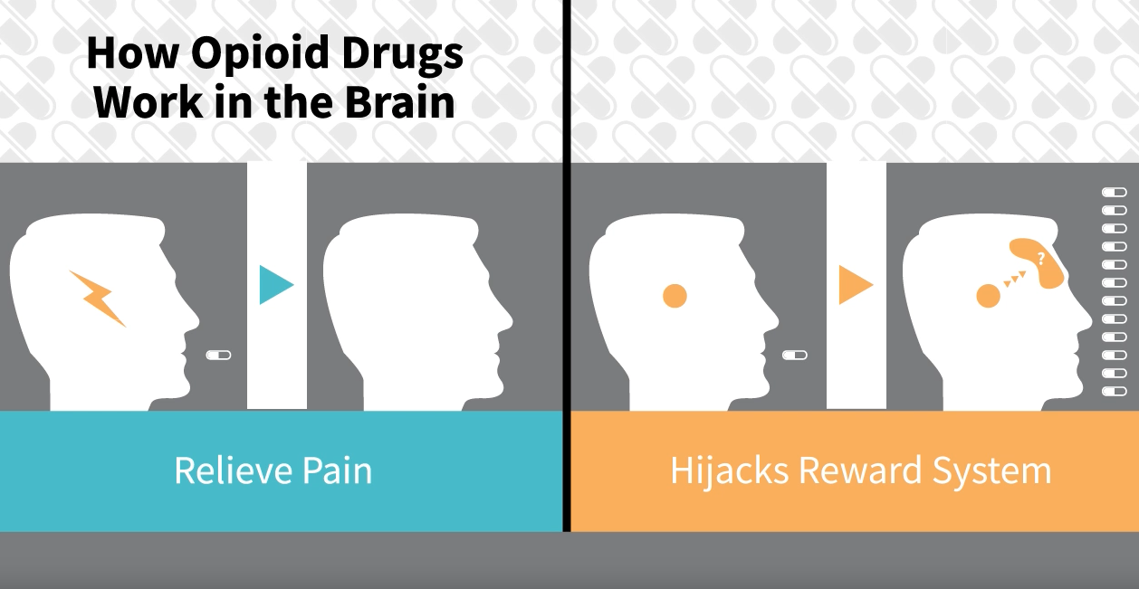
Video:
The Impact of Misusing Prescription Opioids
Notes:
Transition: Let’s watch a video that addresses risks inherent to the misuse of prescription opioids.
Note to facilitator: When you are ready to play the video, minimize this presentation. Once the video is complete, resume this presentation.

Slide 5
What do you think?
Is the misuse of prescription opioids a risky decision?
Notes:
Transition: Based on the video and your own understanding of this issue, is the misuse of prescription opioids a risky decision? What are potential problems or consequences resulting from misusing prescription opioids or heroin?
Note to facilitators: encourage participants to share their thoughts aloud, discuss these questions with their nearby peers, or utilize the “notecard swapping” technique identified in the facilitator guide. Potential problems/consequences with additional talking points are provided on the next slide.

Slide 6
drowsiness
expulsion from school
shallow breathing
drug overdose
addiction
legal fines
felony offense
nausea
decline in grades
confusion
jail
dependency
damaged relationships with family members or friends
loss of job
poor coordination
Notes:
Transition: After the discussion, you may consider simply summarizing the problems noted in the word cloud. Additional talking points associated with these problems are identified below:
Health-related consequences: as noted in the video, the most tragic consequence of prescription drug misuse affects our health -- including drug overdose, which is the leading cause of accidental death in the U.S. Emergency department visits and drug addiction treatment admissions relating to medication misuse have also escalated. In fact, emergency department visits relating to prescription drug misuse now exceed those due to illegal drug use.
Legal consequences: we’ll discuss this in more detail later, but federal law prohibits the possession of the types of prescription drugs which are most often misused without a prescription.
Social consequences: the misuse of medications can affect your family and friends, your job, your education, your finances, and much more.
Transition:
Before advancing the slide, pose this question: How do we avoid these problems?
Note to facilitators: encourage participants to share their thoughts aloud or discuss this question with their nearby peers. Ideas that will be discussed throughout the rest of the program are identified in the next slide.

Slide 7



Rising above the opioid epidemic:
Only use prescribed
opioids as instructed by
a healthcare professional
Secure medications
Avoid mixing drugs
Seek positive alternatives
Ask for help
Notes:
Transition: We can rise above this epidemic by engaging in the following practices. (Note to facilitator: read practices identified on this slide; you might also ask your audience if they have other thoughts on this topic.)
How do we incorporate these practices into our everyday lives?
Let’s address this question by working through some scenarios. We’ll present three scenarios – for each scenario, I’ll pose several discussion questions. You’ll work in small groups (or pairs, or as individuals) to answer these questions.
Note to facilitator: consider incorporating the “Think/Pair/Share” or “Notecard Swapping” methods identified in the facilitator guide to facilitate discussion.

Slide 8
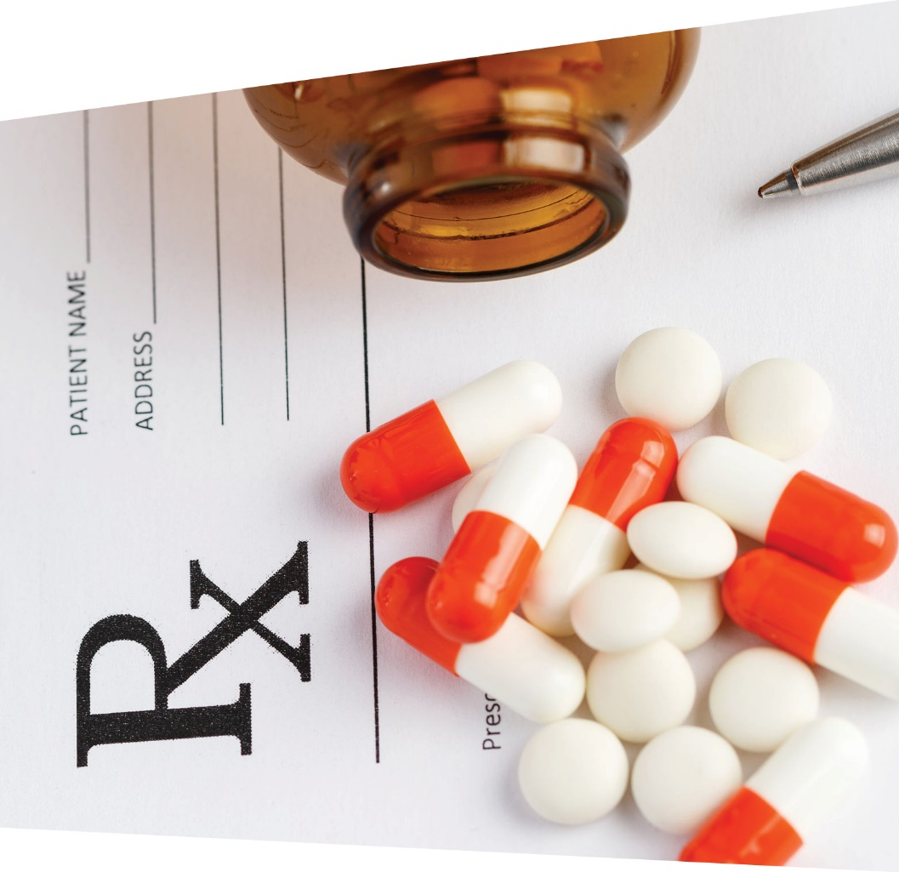
Scenario 1:
A healthcare provider prescribed you a prescription opioid pain reliever…
Notes:
Transition: Research indicates the #1 reason college students misuse prescription opioids is to relieve pain¹. In Scenario 1, let’s pretend that a healthcare provider prescribed you a prescription opioid pain reliever after experiencing a serious injury.
If you receive a legitimate prescription for an opioid pain medication, how do you safely store or dispose of the medication, or respond if your pain isn’t being relieved?

Slide 9
Scenario 1: Legitimate Rx
How do you:
Store the medication?
Respond if your pain isn’t being relieved?
Dispose of the medication?
Notes:
Transition: If you receive a legitimate prescription for an opioid pain medication, how do you safely store or dispose of the medication, or respond if your pain isn’t being relieved?
Note to facilitator: encourage participants to work in small groups or with their neighboring peer to brainstorm answers for each question (i.e. adopt the “Think/Pair/Share” or “Notecard Swapping” methods). After a few minutes, encourage participants to share their ideas with the larger group.
This scenario reinforces how we can rise above the opioid epidemic by using prescription medications safely and securing medications.
How do you safely store the medication? Encourage participants to store medication in lockable spaces, such as lock-boxes, medication safes, or lockable medicine cabinets. Avoid storage places which children and others can easily access, such as unlocked drawers, nightstands, counters, or unlocked cabinets. We encourage these safe storage procedures, because most people who misuse prescription drugs get them from family members or friends.
How do you respond if your pain isn’t being relieved? This question is addressed in slide 10.
How do you safely dispose of medications? This question is addressed in slides 11-12.

Slide 10

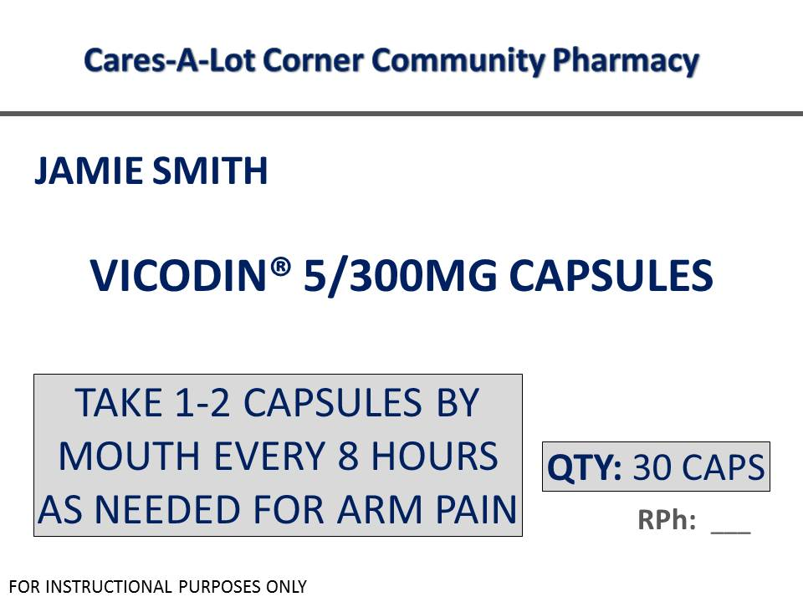
Avoid self-medicating—talk with your healthcare provider
1
How much and how often
2
Reason for medication
Notes:
Transition: If you are taking the prescription opioid as instructed and your pain isn’t being relieved—talk with your healthcare provider.
As demonstrated in the video, there is a risk for dependency and addiction with prescription opioids, even when taken as instructed. Therefore, avoid tendencies to self-diagnose and self-prescribe, which may increase your risk for experiencing these detrimental outcomes.
In addition, current medical guidelines indicate that prescription opioids should really only be used to manage acute pain (i.e., pain lasting for only a short period of time). If you’re experiencing chronic pain (i.e., pain lasting more than three months), effective approaches that do not involve prescription opioids do exist. Again, talk with your healthcare provider to identify these options.
Lastly, when prescribed any medication—be your own advocate. Ensure you understand the reason for the medication and the dosing instructions. Don’t hesitate to ask questions when meeting with your healthcare providers.

Slide 11
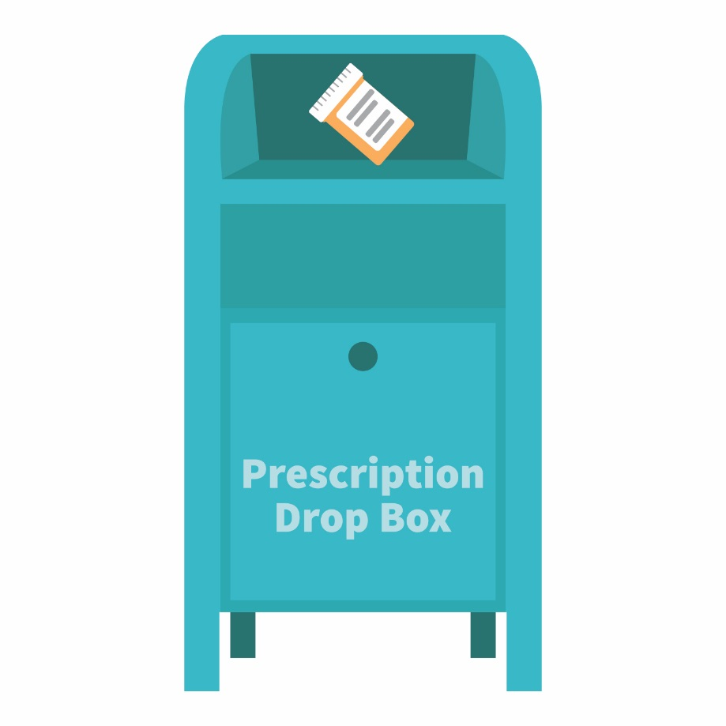
The best option for safe disposal?
Place the medication in a drug drop box or take advantage of a drug take-back event
Visit: rxdrugdropbox.org
Notes:
Transition: Once you are finished with the prescription, it is important to safely dispose of the medication. The majority of individuals that misuse prescription medications get them from their family members or friends.
Once finished with a prescription medication, the best options for safe disposal include:
Option #1: place the medication in a drug drop box. To find a drop box in your area, visit: rxdrugdropbox.org
Option #2: take advantage of community drug take-back programs that allow the public to bring unused drugs to a central location for proper disposal. Call your local law enforcement agency or ask your pharmacist to see if a take-back program is available in your community.

Slide 12


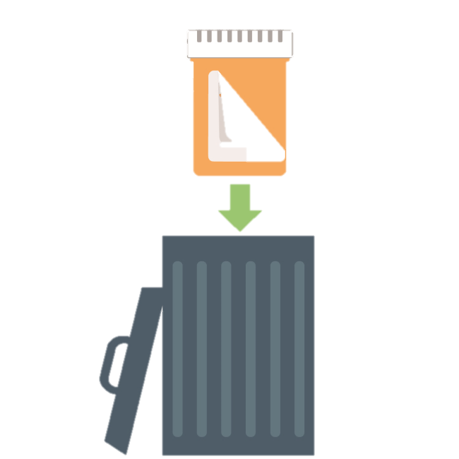

If needed, safely dispose of medications at home:
STEP
STEP
STEP
Notes:
Transition: If a drug drop box or a drug take-back event is not available, you can dispose of the medication at home.
Option #3: dispose of the medication at home (steps illustrated on this slide). Before completing these steps, we encourage you to follow any disposal instructions on the prescription label or patient information sheet.
If disposal instructions are not given, complete these three steps:
Step 1: Remove the pills from the original container and mix them with an undesirable substance such as used coffee grounds or kitty litter.
Step 2: Throw away the sealed mixture into the trash.
Step 3: Remove the prescription label and dispose of the empty bottle.
[Note: In general, you should not flush medications down a toilet or drain; however, the FDA still recommends that certain drugs should be disposed by flushing (for a list, visit: www.fda.gov).]

Slide 13

Scenario 2:
A friend invites you to misuse a prescription opioid…
Notes:
Transition: Let’s work through a second scenario—a friend invites you to misuse a prescription opioid pain reliever. Someone might offer you these types of drugs if you’re experiencing pain or because of the feelings of euphoria they cause. How do you handle this situation?

Slide 14
Scenario 2: Invitation to misuse
If invited to misuse:
Is it legal to possess or take medications
without a prescription?
Is mixing drugs a big deal?
How do you say “no”?
What are positive alternatives to misusing medication?
Notes:
Transition: Consider these questions: Is it legal to possess or take these products without a prescription? In general, is mixing drugs, especially prescription opioids with alcohol, a big deal? And how do you say “no”, as well as identify positive alternatives to misusing medications?
Note to facilitator: encourage participants to work in small groups or with their neighboring peer to brainstorm answers for each question (i.e. adopt the “Think/Pair/Share” or “Notecard Swapping” methods). After a few minutes, encourage participants to share their ideas with the larger group.
This scenario reinforces how we can rise above the opioid epidemic by using prescription medications safely, not mixing drugs, and seeking positive alternatives.
Is it legal to possess the types of medications that are most commonly misused without a prescription? These medications are controlled by the U.S. Drug Enforcement Administration, and it is prohibited under federal law to manufacture, distribute, dispense, or possess them without a legitimate prescription.
Depending on individual state laws, possession of a controlled substance without a prescription may result in a felony charge, with penalties which could include fines and/or imprisonment.
If someone is hurt when you give them your prescription drugs, you could be liable for any harm experienced by the person to whom you provided the medication.
How would a drug-related offense impact your future? Note to facilitator: encourage participants to identify consequences. A felony offense appearing on your record can severely interfere with employment and education opportunities, such as graduate education, summer internships, or employment following graduation.
Is mixing drugs a big deal? This question is addressed on slide 15.
How do you say “no”? Ideas for saying “no” are identified on slide 16.
What are positive alternatives to misusing medication? Ideas for positive alternatives are identified on slide 17.

Slide 15

Mixing Rx opioids with alcohol or with Rx sedatives can cause dangerously slow breathing
Notes:
Transition: All prescription medications have side effects—and mixing alcohol with these products often enhances the negative side effects of the prescription medication.
For example, the adverse effects for prescription opioid pain medications include drowsiness, confusion, sedation, and slowed breathing. Mixing alcohol with prescription opioids can actually worsen these potentially harmful effects.
In fact, many drug overdoses result from mixing prescription opioids with alcohol or with prescription sedatives, which results in dangerously slow breathing that can cause death.

Slide 16

Need help saying “no”?
I’ve got some pain pills…want any?
Give a Reason:
No way…that’s illegal!
I don’t want a drug-related offense on
my record.
Suggest an alternative:
No…these pills can cause some serious side effects. Instead, how about we go to the football game?
Leave the situation:
If you feel uncomfortable, leave the situation and seek a safe way to have fun.
Notes:
Transition: If you’re invited to misuse any prescription medication, how do you turn down this invitation?
Note to facilitators: encourage participants to share their ideas. General approaches including giving a reason, leaving the situation, and suggesting an alternative. Examples are identified on this slide.

Slide 17

Try these positive alternatives…
travel
watch a movie
go to a concert
take a hike
attend a sporting event
host a game night
volunteer
enjoy your hobbies
Notes:
Transition: What are positive alternatives to misusing medication?
Note to facilitator: encourage participants to share their ideas. Examples of positive alternatives are identified on this slide.

Slide 18
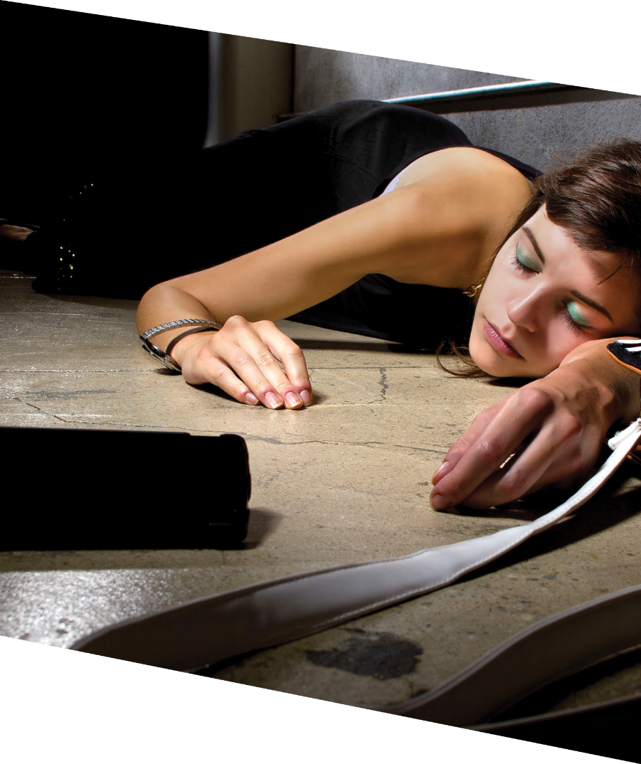
Scenario 3:
You suspect someone has overdosed on an opioid drug…
How do you take action?
Notes:
Transition: Let’s discuss the final scenario—you suspect someone has overdosed on an opioid drug (e.g., heroin, a prescription opioid pain reliever). If you suspect someone has overdosed on any drug, how do you take action?

Slide 19
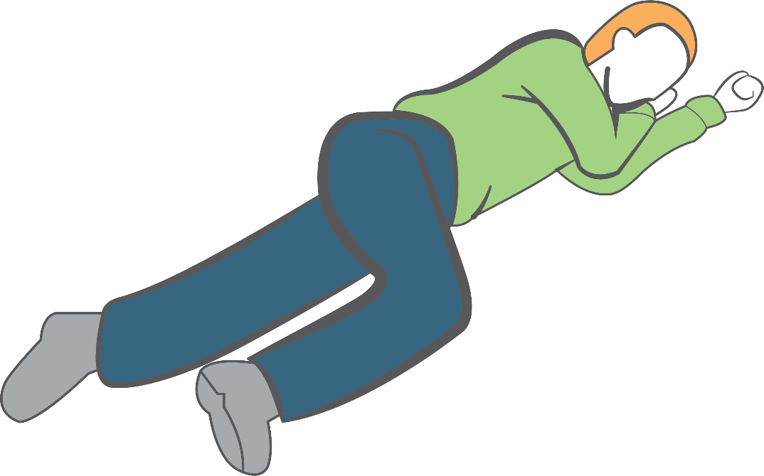
Take action in a drug overdose situation:
Hand
supports
head
Call 9-1-1
Move individual to recovery position
If available, administer naloxone
Stay with the person until help arrives
Knee stops
body from
rolling onto
stomach
Notes:
Transition: If you suspect someone has overdosed on any drug, how do you take action?
First, call 9-1-1.
Second, move the individual to the recovery position (place the individual on their left side—place their arms under their head, and bend their right leg in order for their knee to stop their body from rolling onto their stomach). This position is designed to prevent suffocation.
Third, if available, administer naloxone. More information on naloxone is available on slide 20.
Lastly, stay with the individual until help arrives.

Slide 20
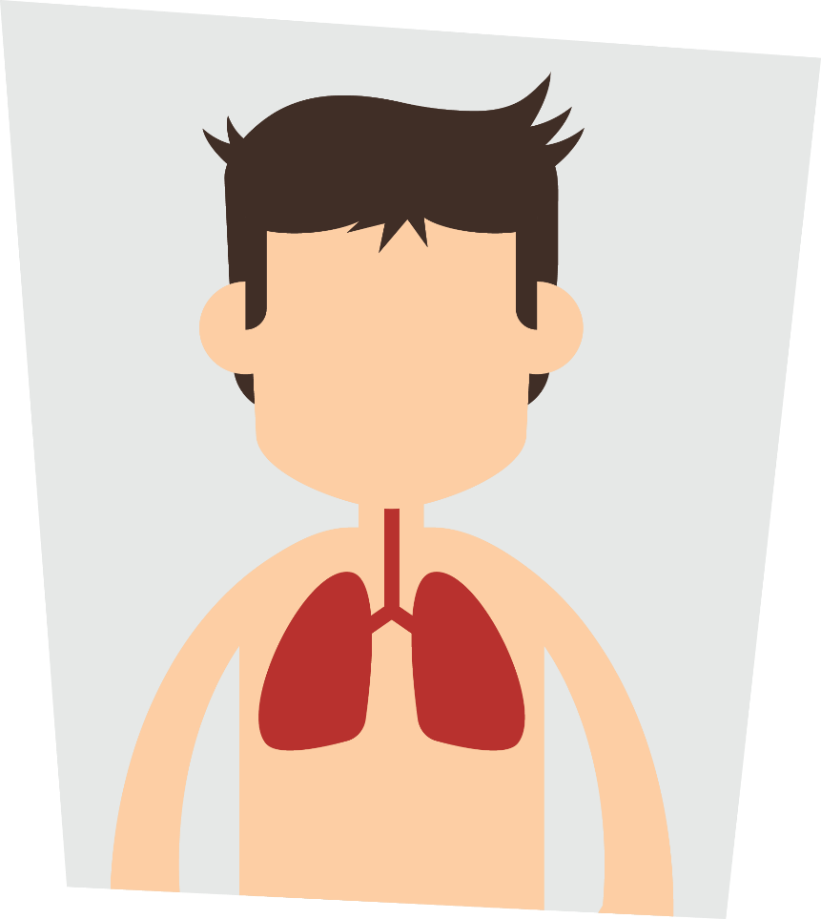
Naloxone reverses opioid drug overdoses
Two forms: auto injector or intranasal spray
Naloxone access varies from state to state
Consider precautions with naloxone use
Notes:
Transition: As noted in the video, in an overdose situation, opioids cause death through modifying the brain’s respiratory center—essentially, you stop breathing. By administering naloxone, the ability for the opioid drug to stop respiration is blocked or prevented, and the individual resumes breathing.
Naloxone is available as an auto injector or as an intranasal spray.
Accessing naloxone by the general public varies from state to state. To find a naloxone distribution program in your area, consult the search engine labeled, “Overdose Prevention Program” at the following site: http://harmreduction.org/overdose-prevention/overdose-news/prescribe-naloxone/
It is critical to remember two precautions regarding the use of naloxone:
Because of naloxone’s actions in the body, it will precipitate withdrawal symptoms (e.g., vomiting, individual becomes combative or agitated) upon administration in an individual physically dependent on opioid drugs.
If the patient actually overdosed on a non-opioid drug (prescription sedatives, alcohol, etc.), administering naloxone will have no effect and it will not rescue breathing.
For more information on naloxone, visit “Learn/Helping Others” at GenerationRx.org.

Slide 21

Need help? Use
Campus Resources:
Student health or
wellness center
Campus Recovery Programs
College or university counseling services
Academic advisors
Notes:
Transition: if you need help, we encourage you to use campus resources.
Note to facilitator: prior to the presentation, we encourage you to customize this slide for your university. Discuss each resource with participants, and consider providing this information to participants through email or other digital platforms.
As with any disease, treatment options include both pharmacological (e.g., medication-assisted treatment using drugs like buprenorphine) and non-pharmacological (e.g., behavioral counseling) approaches. If you or someone you know needs help, campus resources such as the student health center, campus recovery programs, or campus counseling services can help identify appropriate treatment options.

Slide 22

Share the information
Visit: GenerationRx.org
Notes:
Transition: In addition, we encourage you to share these messages with others.
This may consist of discussing Generation Rx messages with family and friends, or sharing them through peer-to-peer education. Visit our website, GenerationRx.org, to access free, ready-to-use resources designed to educate college students (or people of any age). You could present this program or a different activity. You could also present similar educational programs to other audiences, like teens, using our age-appropriate resources.

Slide 23
Rising above the opioid epidemic:
Only use prescribed
opioids as instructed by
a healthcare professional
Secure medications
Avoid mixing drugs
Seek positive alternatives
Ask for help
Notes:
Transition: In summary, we can each do our part to rise above the opioid epidemic by taking medication as instructed by a healthcare professional, securing medication through safe storage and disposal practices, not mixing drugs, seeking positive alternatives to better manage our lives, and if needed, asking for help.

Slide 24



GenerationRx.org
Follow us
@TheGenRx
Notes:
Transition: Does anyone have any questions or comments?
Before we end, we encourage you to stay connected by following us @TheGenRx on Twitter and Facebook.
Also, we encourage you to take a survey evaluating today’s program on GenerationRx.org. You can find a link to this survey at the bottom of the home page. We value your feedback to help us assess the impact of this work and continually improve Generation Rx materials.
Note to facilitator: we encourage you, as the presenter, to also complete this survey. Thank you for advocating safe medication practices in your community!
We also encourage you to share your experience with us. Consider submitting your tips and personal experiences about how you advocate safe medication practices at home or in your community. To do this, visit the ‘Contact’ section of GenerationRx.org. In this same section, you can also submit any questions you may have regarding how to use these educational resources.

